Slide 1
Upper Extremity Strains and Sprains
Orrin Franko
East Bay Hand Medical Center

Slide 2


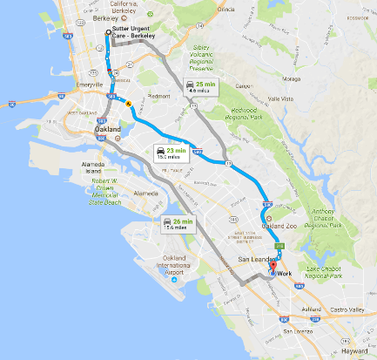
www.EBHMC.com

Slide 3
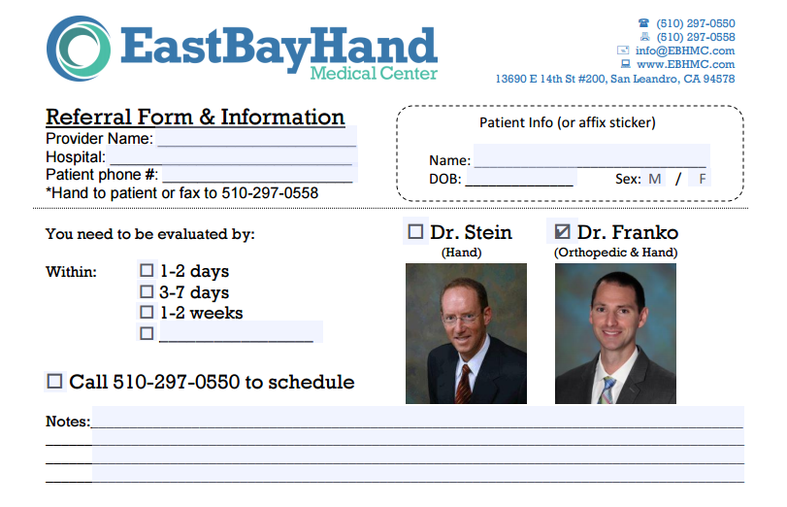
Cell: 858-337-7149 www.ebhmc.com/referral

Slide 4
Table of Contents
Shoulder
  AC dislocation
  Shoulder dislocation
  Biceps tendonitis
Elbow
  Lateral epicondylitis
  Medial epicondylitis
Wrist
  DeQuervain tendonitis
  Sprains
Fingers
  PIP joint dislocation/subluxation/sprain
  Mallet finger / Central slip avulsion
  Thumb UCL rupture
  Trigger Finger

Slide 5
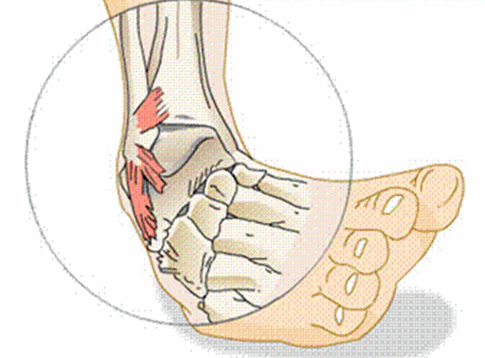
General Knowledge
Sprains
A sprain is a stretch or tear of a ligament.
Ligaments connects one bone to another.
Ligaments have poor blood supply (that’s why they are white!) so healing can take 3-12 months

Slide 6
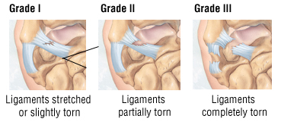
Grades
Sprain Classification
Grade 1: some stretching and some damage to the fibers
Grade 2: A partial tearing with some subluxation
Grade 3: Complete tears and dislocations

Slide 7
Signs and symptoms
Treatment
Pain
Swelling
Bruising
Inflammation
Grade 1
  RICE
  Physical Therapy
Grade 2
  Bracing
Grade 3
  Surgery to repair the torn ligaments.

Slide 8
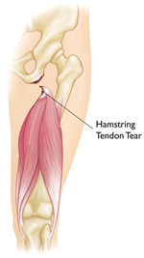
Strains
A direct injury to muscles or tendons.
Tendons connect muscles to bones
Like ligaments, they have poor blood supply
They are often under “high stress” and require modified activity or protection to heal

Slide 9
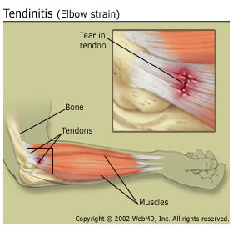
Symptoms
Treatment
Pain
Muscle spasm
Muscle weakness
Swelling
Inflammation
Cramping
RICE
Specific exercises to regain mobility
Surgery

Slide 10
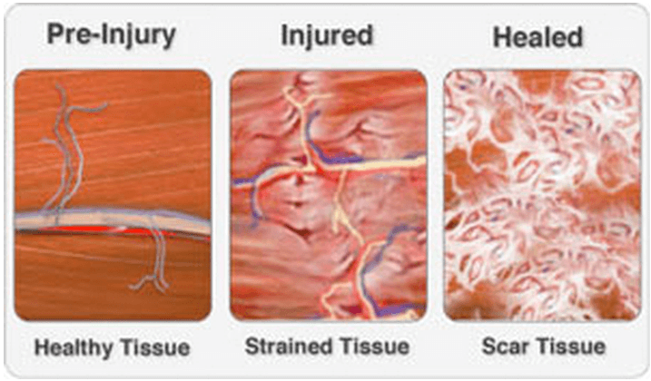
Strains

Slide 11
“Shoulder Separation” = AC Dislocation
Def: A sprain of the acromioclavicular ligament
Mechanis: fall on the outstretched arm tip of the shoulder
  Cyclists

Slide 12
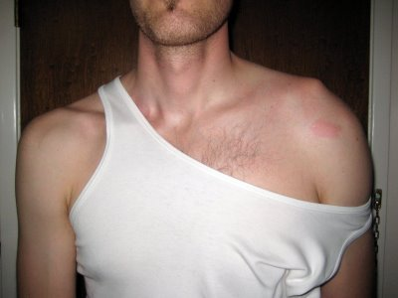
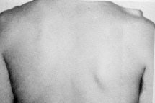
Anterior View
Posterior View

Slide 13
• Sx: Point tenderness over AC joint
- inability or pain with abduction
- in some cases, gross deformity
• Tx: Immobilization with a sling
- ice
- NSAIDS
- if grade III or above, refer to a surgeon
- if grade I protective padding

Slide 14
Rotator Cuff Strain
3 degrees
Most involve supraspinatus
Tears usually at insertion on humerus

Slide 15
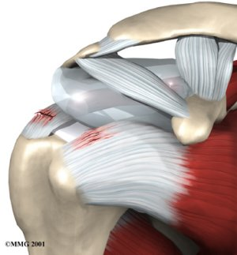
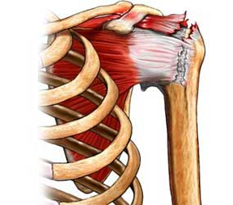
Rotator cuff strain

Slide 16
Mechanism
Dynamic rotation of arm at high velocity (overhead throwing)
Usually involves individuals with a history of impingement or instability

Slide 17
Signs & symptoms
Pain w/ muscle contraction
Tenderness over greater tuberosity
Loss of strength
Complete tear produces pain, loss of function, swelling and POT

Slide 18
Treatment
RICE
Decrease level of activity
Exercises to strengthen rotator cuff

Slide 19
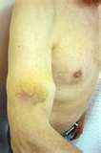
Biceps tendon rupture

Slide 20
Mechanism
Direct blow
Severe contraction of biceps

Slide 21
Signs & symptoms
Pain and bruising through arm
Deformity of biceps—balling up of muscle belly
Pain with elbow flexion or supination

Slide 22
Treatment
Ice
Immobilization (short term)
Physical therapy

Slide 23
Tendonitis
Rotator cuff
Biceps
Common among athletes performing overhead motions due to overuse or muscle weakness

Slide 24
Mechanism
Repetitive overhead motion causing inflammation of tendon

Slide 25
Signs & symptoms
Tenderness to palpation
Swelling
Crepitus
Pain with motion

Slide 26
Treatment
Rest
Ice
Heat
NSAIDS
Stretching
Strengthening
Activity modification (reduction in pitching for adolescents)

Slide 27
Impingement syndrome
Involves compression of supraspinatus tendon, subacromial bursa, long head of biceps tendon (all are under the coracoacromial arch)

Slide 28
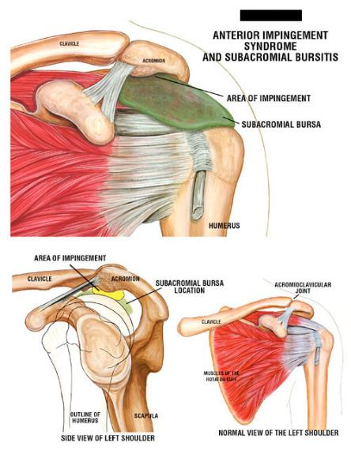
Impingement

Slide 29
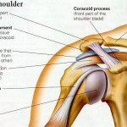
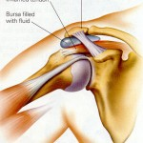
Impingement

Slide 30
Mechanism
Repetitive overhead motions

Slide 31
Signs & symptoms
Diffuse pain around the acromion process when arm is in overhead position
External rotators are weak
“+” impingement test
Empty can test may increase pain
Pinching sensation

Slide 32
Treatment
RICE
Restore normal biomechanics to shoulder
Strengthen RC muscles and muscles that produce movement of scapula
Stretch posterior and inferior joint capsule

Slide 33
Elbow

Slide 34
Lateral Epicondylitis (tennis elbow)
Pathology
  30 – 50 years old
  Repetitive micro-trauma
  Chronic tear in the origin of the extensor carpi radialis brevis

Slide 35
Lateral Epicondylitis (tennis elbow)
Mechanism of Injury
  Overuse syndrome caused by repeated forceful wrist and finger movements
  Tennis players (rarely)
  Prolonged and rapid activities

Slide 36
Lateral Epicondylitis (tennis elbow)
Clinical Signs and Symptoms
  Increased pain around lateral epicondyle
  Tenderness in palpation Tests
    AROM; PROM
    Resisted tests
    Lidocaine

Slide 37
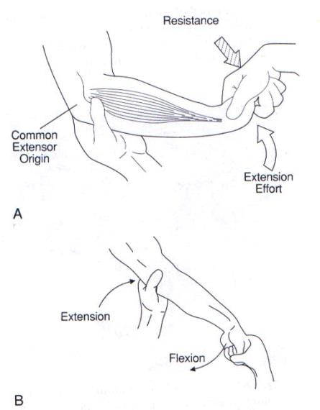

Slide 38
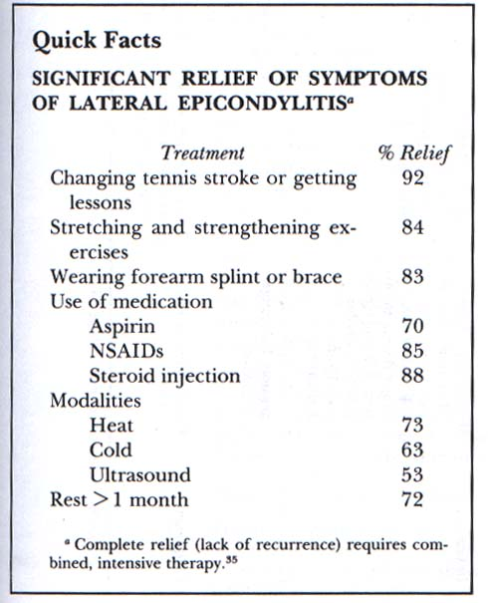
Treatment of Tennis Elbow
Time
Time
Time
Steroid shot
Time
Therapy
Time
…and give it more time

Slide 39
Medial Epicondylitis (golfer’s elbow)
Pathology
  30 - 50 years old
  Repetitive micro trauma to common flexor tendon

Slide 40
Medial Epicondylitis (golfer’s elbow)
Mechanisms of injury
  Throwing a baseball
  Racquetball or tennis
  Swimming backstroke
  Hitting a golf ball

Slide 41
Medial Epicondylitis (golfer’s elbow)
Clinical signs and symptoms
  Increased pain over medial epicondyle
  Tenderness on palpation
  Tests
    AROM; PROM
    Resisted tests
    Lidocaine

Slide 42
Medial Overload Syndrome in Throwers
Pathology
  Lateral joint line- compressive forces
  Shear forces posteriorly in olecranon fossa
  Tensile forces along medial joint line

Slide 43
Medial Overload Syndrome in Throwers
Clinical signs and symptoms
  Persistent medial elbow soreness
  Arm fatigue is the 1st indicator of impending injury
  Medial tenderness
  Elbow pain

Slide 44
Medial Overload Syndrome in Throwers: Treatment
  Pre throwing stretches
  Adequate gentle warm up with gradual increase to higher velocity throws
    Using safe pitch counts for adolescents
  Post throwing stretching
  ICE after throwing
  Surgical Intervention

Slide 45
Wrist

Slide 46
Wrist Sprain
Mxn:
  Abnormal forced movement of the wrist
  Falling on hyperextended or hyperflexed wrist
  Violent torsion

Slide 47
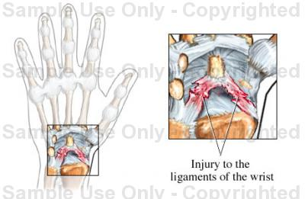
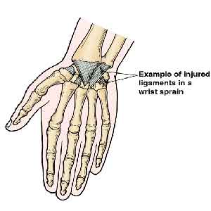
Wrist Sprain

Slide 48
S/S:
  Pain
  Point tenderness
  Swelling
  Difficulty moving wrist—limited ROM

Slide 49
TX:
  RICE for mild/ moderate
  Physician referral to rule out fx for severe
  Splint if necessary
  Exercises for strengthening and ROM
  Tape for support

Slide 50
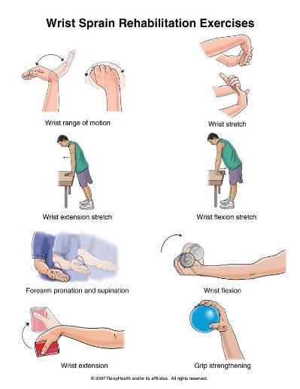
Treatment for wrist injuries

Slide 51
Wrist Tendonitis
Mechanism: repetitive motion at wrist—usually in flexion/extension
  Seen more often in athletes involved ins sports with repetitive acceleration and deceleration
    i.e. weight lifters, rowers

Slide 52
TX:
Ice
Heat
Analgesics
Modify activity
NSAIDS
Splint
Strengthening and ROM exercises

Slide 53
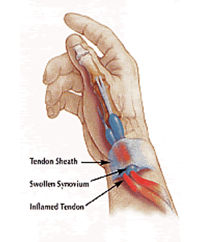
DeQuervain’s Tenosynovitis
Tendonitis specifically to the 1st Dorsal Compartment
+ Finklestein test
90% response to a single steroid injection
Splinting temporarily may help
NSAIDs can help
Remaining require surgery for pain relief

Slide 54
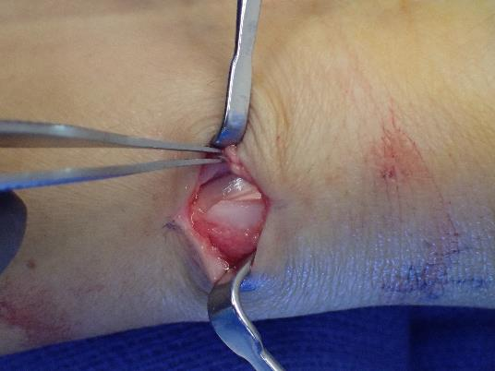
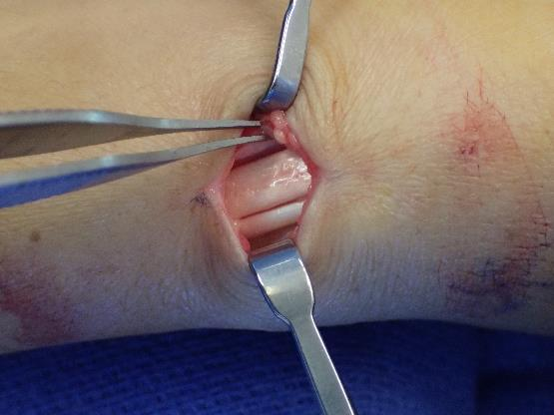
DeQuervain’s Tenosynovitis

Slide 55
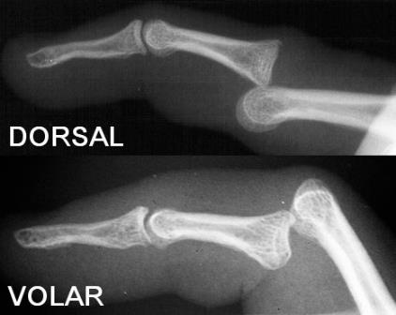
PIP Joint Dislocations / Subluxations
Dorsal more common
Simple dorsal dislocation: reduce, buddy tape
Fracture-dislocation
  Splint in stable position
Volar dislocation:
  Open reduction required in most cases

Slide 56
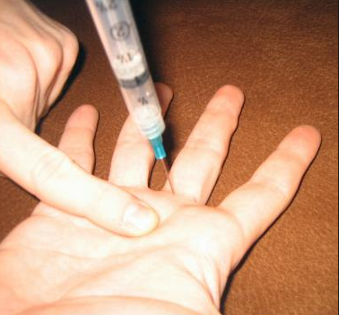
Reduction Techniques
Digital block:
  5cc 1% lidocaine
  Volar at the digital crease – right in the middle
  One shot – works every time.

Slide 57
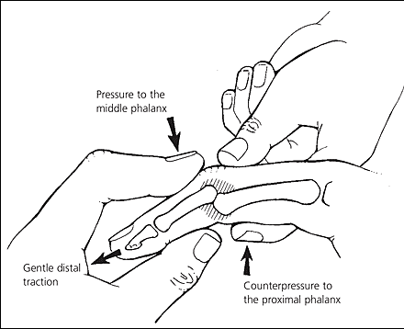
Reduction Techniques
Re-create deformity, traction

Slide 58
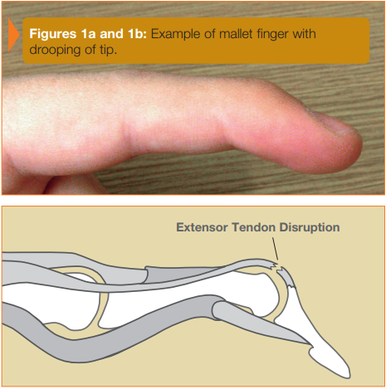
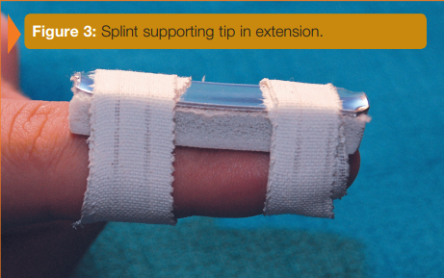
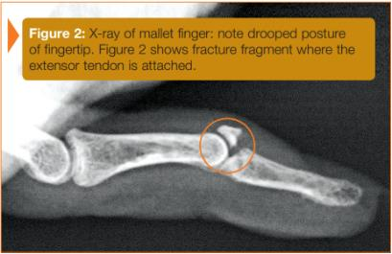
Mallet Finger / Central Slip

Slide 60
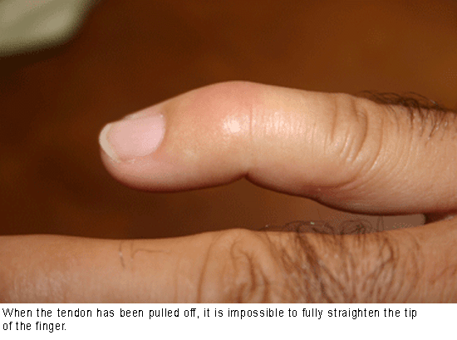
MALLET FINGER

Slide 61
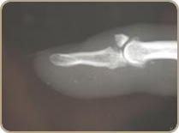
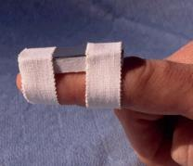
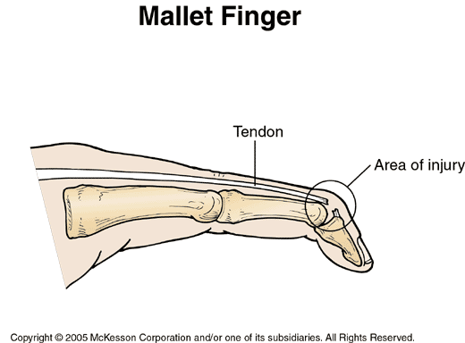
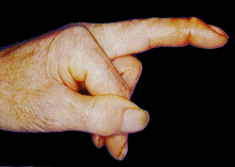
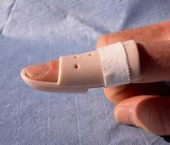
MALLET FINGER
ANATOMY
  Dorsal avulsion
  Extensor digitorum tendon tear
MECHANISM:
  Forced flexion of extended digit
TREATMENT:
  No fracture: DIP extended for 6-8 weeks
  FRACTURE: if <30% joint surface, splint x 4 weeks
  If >30%→ Might need ORIF
  Less than full passive extension?????
COMPLICATIONS:
  Pressure necrosis from splint
  Permanent extensor lag

Slide 62
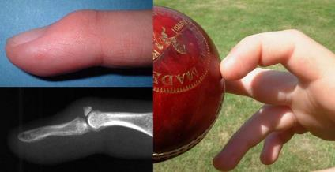
Mallet Finger Presentation
Pain at dorsal DIP joint
Inability to actively extend the joint
Characteristic flexion deformity
On exam, very important to isolate the DIP joint to ensure extension from DIP and not the central slip
If can’t passively extend consider bony entrapment
All of these need x-rays
Notes:
Figure 2.
Injury to the joint extensor tendon at the distal interphalangeal joint (mallet finger)

Slide 63
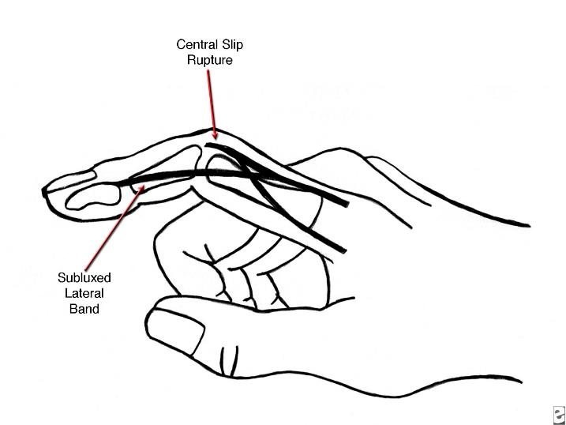
CENTRAL SLIP AVULSION
ANATOMY
  Extensor digitorum communis tendon disruption
  Lateral bands migrate in volar direction
MECHANISM:
  Volar-directed force on middle phalanx against semi-flexed finger attempting to extend

Slide 64
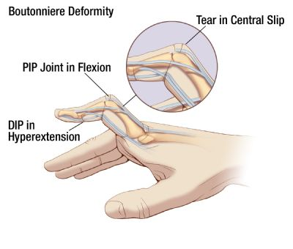
CENTRAL SLIP AVULSION
EXAM:
  Pain, swelling over dorsal PIP
  PIP in 15-30 degrees flexion
  May have limited extension (better at 0 degrees than 30 degrees)
TREATMENT
  Surgery if >30% joint surface involved with avulsion fx
  PIP splint in full extension 4-5 weeks
  Protect 6-8 weeks for sports
  *allow DIP to flex- relocates lateral bands
COMPLICATIONS:
  Boutonierre deformity

Slide 65
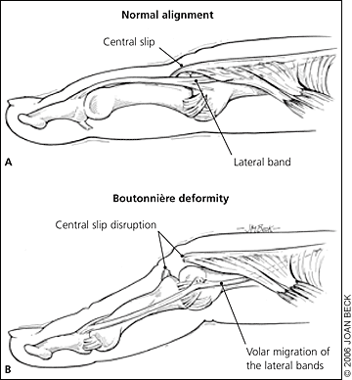
Central Slip Extensor Tendon Injury- Boutonnière deformity
PIP joint is forcibly flexed while actively extended
Volar dislocation of the PIP joint
Examine with PIP joint in 15-30 degrees of flexion, can’t active extend but can passively extend
Tenderness over dorsal aspect of the middle phalanx
Notes:
Commonly occurs in basketball
Figure 6.
Boutonniére deformity caused by a central slip extensor tendon injury. (A) Normal alignment. (B) Boutonniére deformity.

Slide 66
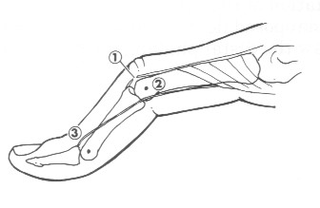
Central Slip Extensor Tendon Injury Treatment
A delay in proper treatment will cause boutonniere deformity
Deformity can develop over several weeks or occasionally acutely
Splint PIP in extension for 6 weeks
Can still play sports
Notes:
Boutonnier- flexion of PIP coupled with extension of MCP and DIP
Takes several weeks- lateral bands slip inferiorly

Slide 67
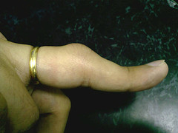
Central Slip Extensor Tendon Injury
Avulsion fracture involving more than 30 percent of the joint
Inability to achieve full passive extension

Slide 68
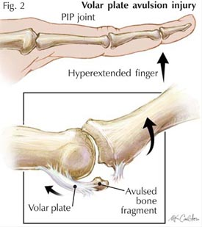
Volar Plate Injury
Hyperextension, such as dorsal dislocation
PIP is usually affected
Collateral damage is often present
The loss of joint stability can cause hyperextension deformity

Slide 69
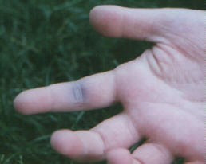
VOLAR PLATE RUPTURE
EXAM FINDINGS:
  Tender volar PIP
  Bruising, swelling
MECHANISM:
  Hyperextension injury
  Ruptures distally from attachment at middle phalanx

Slide 70
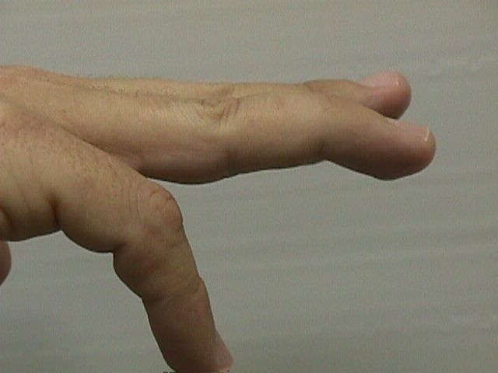
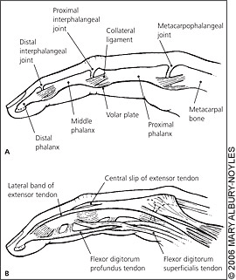
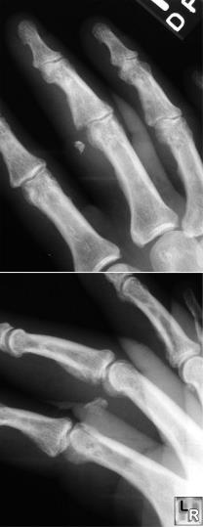
VOLAR PLATE RUPTURE
TREATMENT:
  Early mobilization
  Extension block splint
  Buddy tape
  Surgery if >30% joint involved
COMPLICATIONS:
  Swan neck deformity: extensor tendons pull PIP into hyperextension, DIP flexion
Swan Neck Deformity

Slide 71
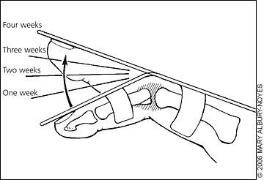
Volar Plate Injury- Treatment
Progressive splinting starting at 30 degrees flexion
Followed by buddy taping
If less severe, can buddy tape immediately
Can play sports if splinted

Slide 72
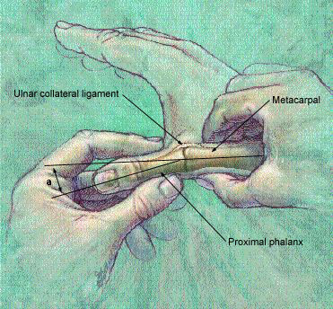
GAMEKEEPER’S THUMB
MECHANISM
  Hyperabduction of thumb
  EXAM:
  Weak, painful pinch
  Pain over ulnar thumb
  XRAYS BEFORE STRESS
Notes:
Type I: avulsion, no displacement; Type II: avulsion, displaced; Type III: torn ligament, stable in flexion; Type IV: torn ligament, unstable flexion

Slide 73
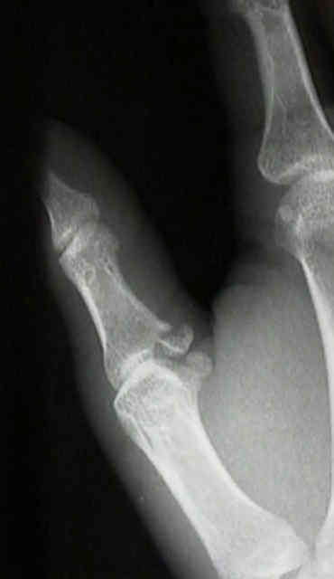
GAMEKEEPER’S THUMB
SIGNS
  Pain over ulnar thumb
  Stress testing positive
    Testing in Extension and 40 degrees of FLEXION of MCP
Notes:
With extension or slight flexion the normally taut volar plate gives MCP stability
Type I: avulsion, no displacement; Type II: avulsion, displaced; Type III: torn ligament, stable in flexion; Type IV: torn ligament, unstable flexion

Slide 74
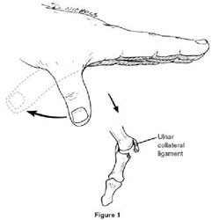
Ulnar Collateral Ligament Injury of the Thumb (Skier’s Thumb)
Caused by forced abduction of the 1st MCP joint
Left untreated the joint will be unstable with weak grip strength

Slide 75

Skier’s Thumb- Diagnosis
Difficulty opposing pinky to thumb
Swelling and black and blue over thenar eminence
Can’t hold an OK sign
Consider digital block and to facilitate ligament testing
Notes:
Kim does not digital block, nor has she ever seen anybody do it

Slide 76


Stener Lesion
Notes:
Figure 8. Stener lesion. Note that the proximal end of the UCL displaces outside of the adductor
aponeurosis. (UCL = ulnar collateral ligament.)
Adductor Aponeurosis: fibers of the adductor pollicis tendon (intrinsic hand muscle) with fibers of the extensor aponeurosis
One of the big debate is when to get the MRI.
Pt. wants to avoid the OR. Fine after a cast for 6 weeks because stiff but will loosen up. MRI can help show the patient.

Slide 77
Skier’s Thumb Grading/Treatment
Grade 1
  Pain without instability with stress
  Splinting 1-2 weeks
Grade 2
  Pain with mild instability: gapping <20 degrees
  Casting 3-6 weeks
Grade 3
  Stenner’s Lesion
  Instability: gapping > 20 degrees or > 35 degrees compared to unaffect thumb
  Early surgical intervention within 2-3 weeks

Slide 78

Skier’s Thumb Treatment

Slide 79

Stenosing Tenosynovitis (Trigger Finger)
Background
  2% lifetime risk of developing
  At least 2 times as common in women
  Not an inflammatory condition!
  Ring finger most commonly affected digit
  Multiple trigger digits more common in patients with:
    Diabetes
    Thyroid problems

Slide 80

Stenosing Tenosynovitis (Trigger Finger)
2% lifetime risk of developing
Symptoms
  Painful triggering, often worse in the AM
    Patient often describes the popping as being their PIP
  Pain over the A1 pulley
  May describe that the finger “no longer bends”
Notes:
Classification not worth knowing, but it does demonstrate the spectrum of pathology

Slide 81
Stenosing Tenosynovitis (Trigger Finger)
Pathoanatomy
Notes:
Classification not worth knowing, but it does demonstrate the spectrum of pathology

Slide 82

Stenosing Tenosynovitis (Trigger Finger)
Pathoanatomy

Slide 83
Stenosing Tenosynovitis (Trigger Finger)
Treatment
  Corticosteroid Injection
    86% effective at 3 months
    50% effective at 12 months
    May take up to 6 weeks to be effective!
  Open surgical Release of A1 pulley
    Can be done wide awake under
    local anesthesia only
  Oral Medications
    Tend not to be effective
  Splinting
    May be helpful for symptoms but not long term treatment
Notes:
*Despite the fact that it is not an inflammatory condition!

Slide 84
Trigger Finger Injection Technique
1.5cc total in 3cc syringe (25g x 5/8” needle)
  0.5cc celestone
  0.5cc 1% lidocaine
  0.5cc 0.5% marcaine
Warn patient that finger tip may be “numb and tingly” for 4-6 hours

Slide 85

Trigger Finger Injection Technique
Inject halfway between distal palmar crease and palmar digital flexion crease (except thumb)
  This is right over A1 pulley
Insert needle and inject a little to anesthetize the skin
Then advance needle and wait for “give” as you have gentle pressure on the syringe plunger
  Can also do this in reverse as you withdraw
Be aware of trajectory of flexor tendons!
Studies show no difference whether or not injxn in sheath
Palmar Digital Flexion Crease
X
X
X
X
Distal Palmar Flexion Crease
X
Thenar Crease

Slide 86
Stenosing Tenosynovitis (Trigger Finger)
When to Refer
  Patient does not want to undergo injection
  Patient has recurrent symptoms after 1 or 2 injections
  Locked trigger finger (*)
Notes:
*Despite the fact that it is not an inflammatory condition!

