Slide 1
Common Hand Conditions in Urgent Care Update for 2017
Orrin Franko
Orthopedic & Hand Specialist

Slide 2
Disclosures
Owner/Founder: www.TopOrthoApps.com
Owner/Founder: www.SurgiSurvey.com
No relevant financial disclosures related to the topic of this presentation.

Slide 3
Orrin I. Franko, MD
Childhood: Palos Verdes, CA
Undergraduate: UC San Diego (2005)
Medical: Harvard (2009)
Orthopedic Residency: UC San Diego
Hand Fellowship: Cincinnati, OH
Wife (Katie), 2 boys: Ari (3 yrs) & Asher (2 yrs)
Hobbies: “Tech” and “mobile apps” in medicine
www.TopOrthoApps.com
Automated Surgical Outcomes
Online Physician Rating & Reputation Management

Slide 4
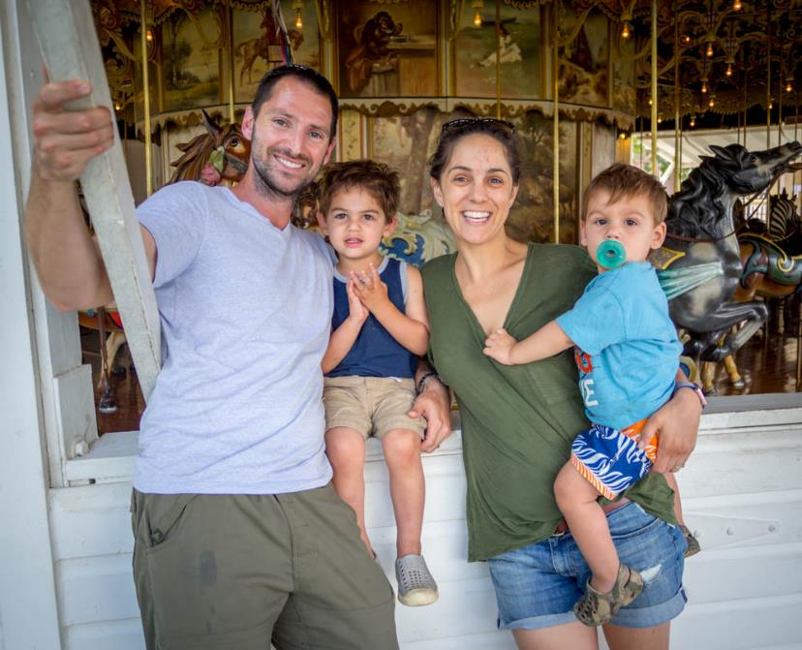
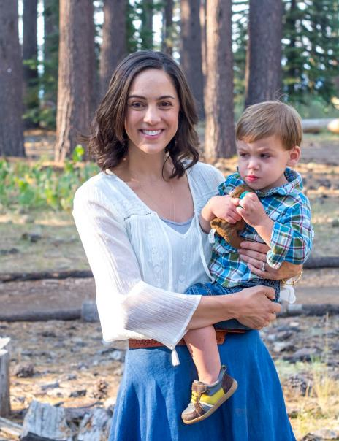
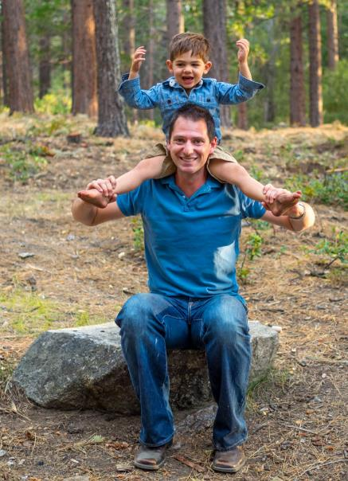

Slide 5
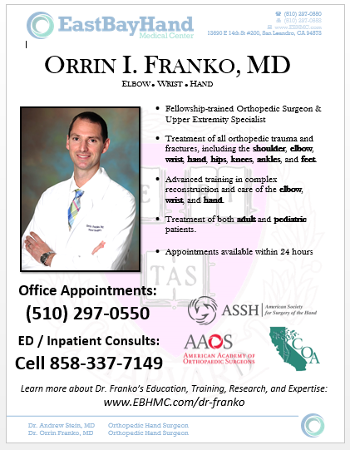
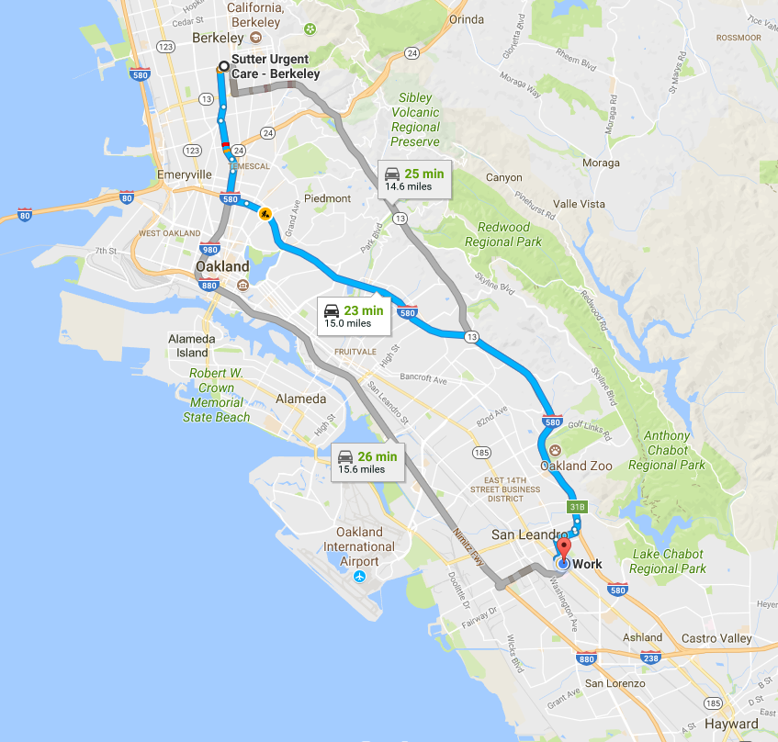
www.EBHMC.com

Slide 6
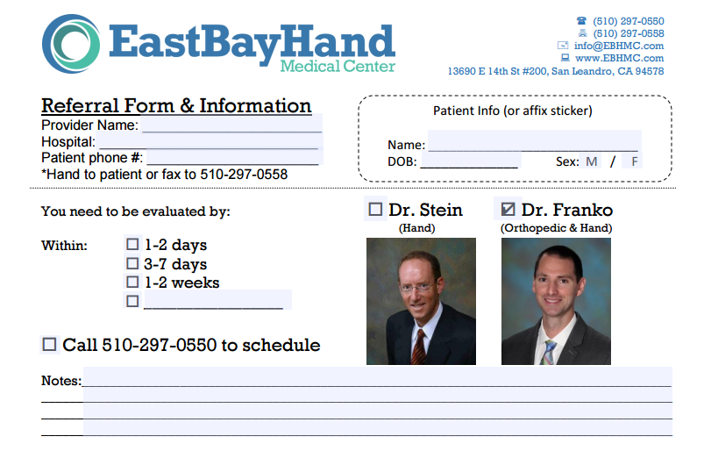
Cell: 858-337-7149 www.ebhmc.com/referral

Slide 7
The Hand
Hand Exam
Nerves, Tendons, Bones
Distal radius fractures
Metacarpal fractures
Finger fractures and dislocations
Nail / Nailbed injuries

Slide 8
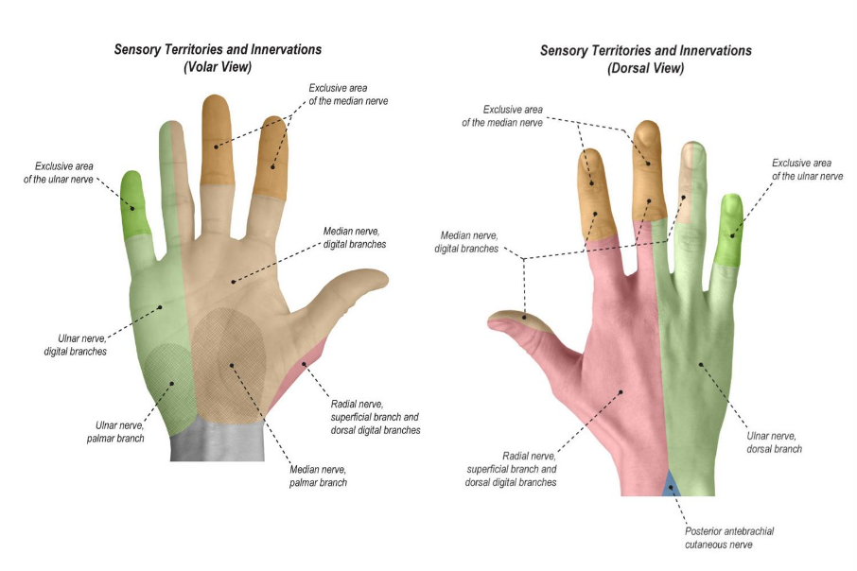
Hand Exam: Sensation

Slide 9
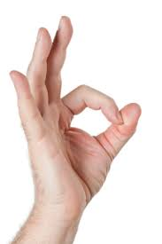
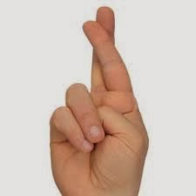
Hand Exam: Motor
Radial nerve: thumb IP joint extension (EPL)
Median nerve/AIN: thumb IP joint flexion (FPL), index DIP flexion (FDP)
Ulnar nerve: cross fingers or abduct against resistance (interossei)

Slide 10
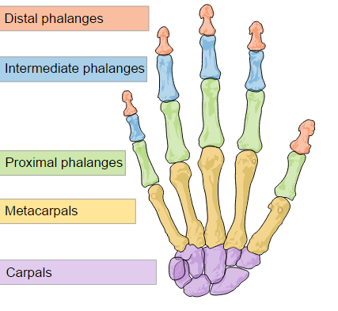
Hand Exam: Bones
Middle

Slide 11
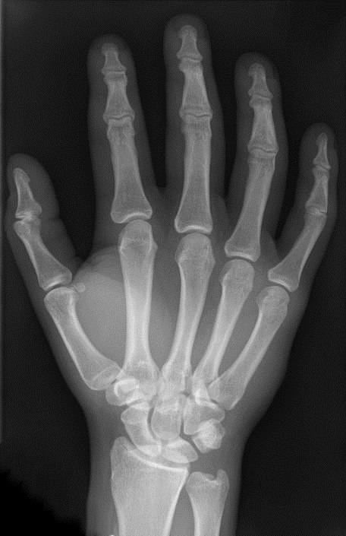

Slide 12
Tip #1:
Any injury → Remove rings and jewelry

Slide 13
4 weeks post Distal Radius Fracture!

Slide 14
Distal Radius Fractures
More than just “plate and screws” fixation
Newer literature suggests personalized treatment…
Elderly → no surgery regardless of age
Impaction → dorsal and volar plating
Comminution → spanning plate to prevent collapse
Distal → pin/plate design for small fragments
Borderline → closed reduction and cast

Slide 15
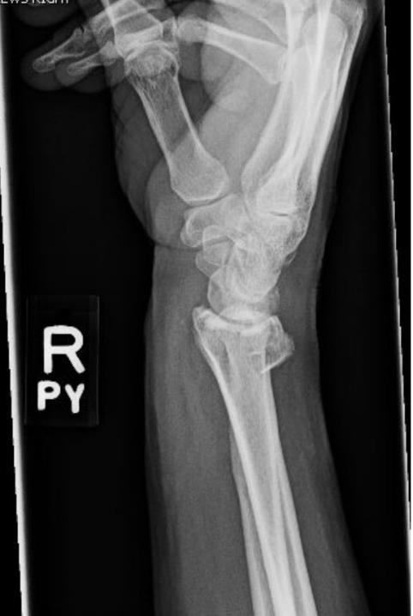

Slide 16
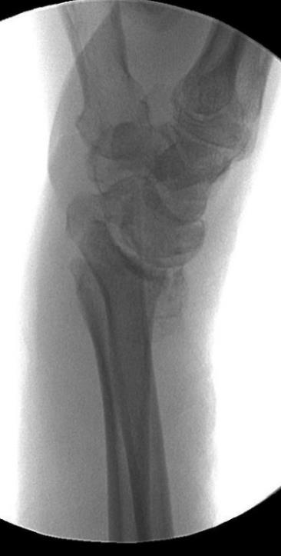
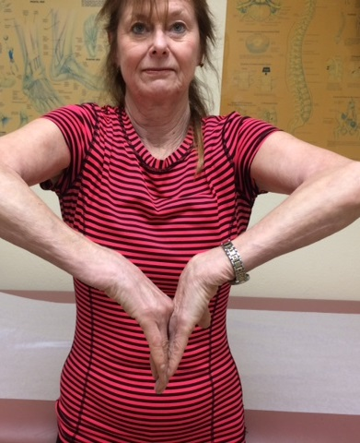
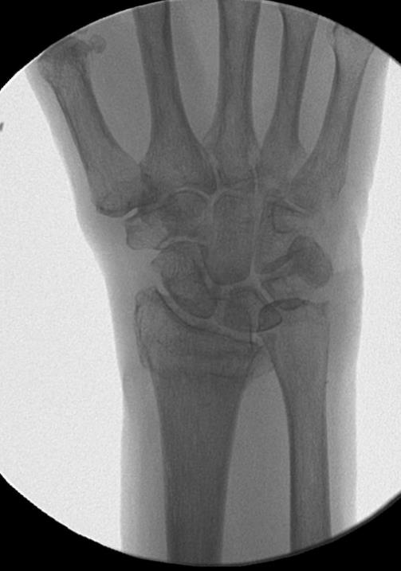
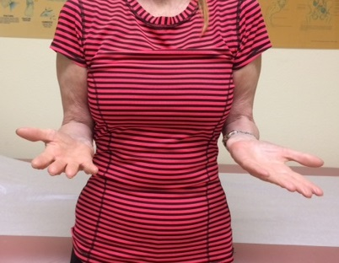
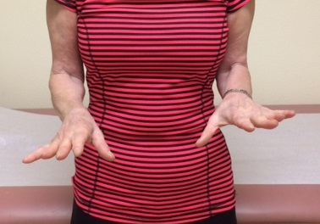

Slide 17
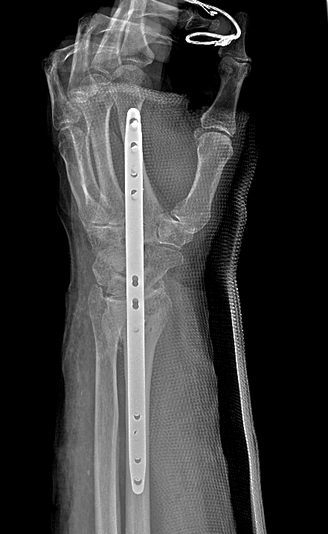
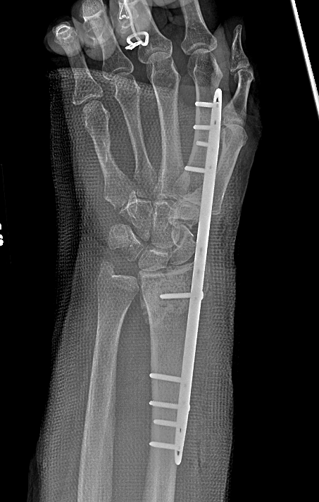
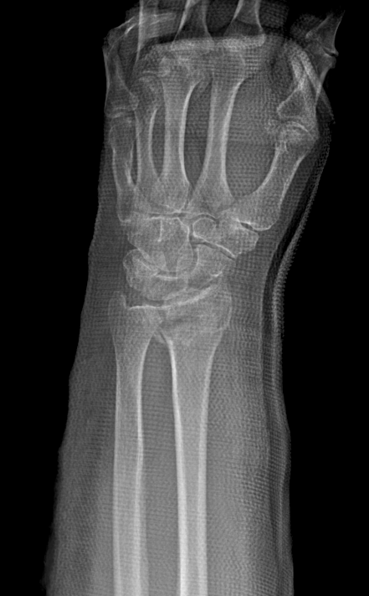
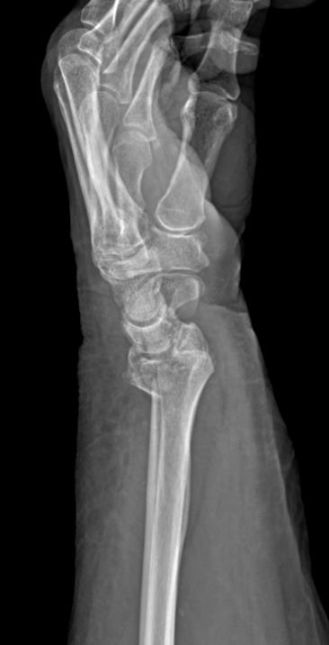

Slide 18
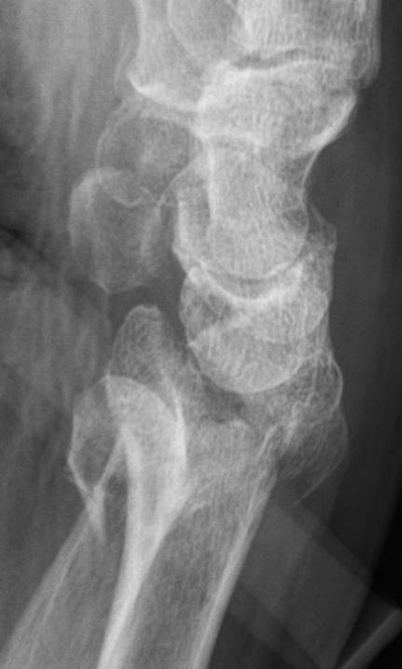
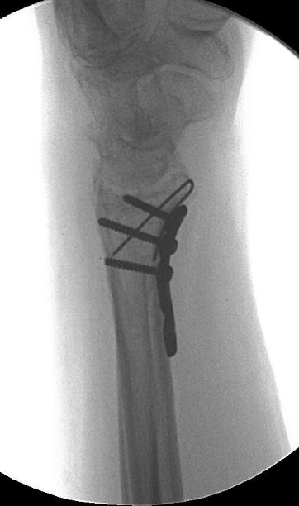
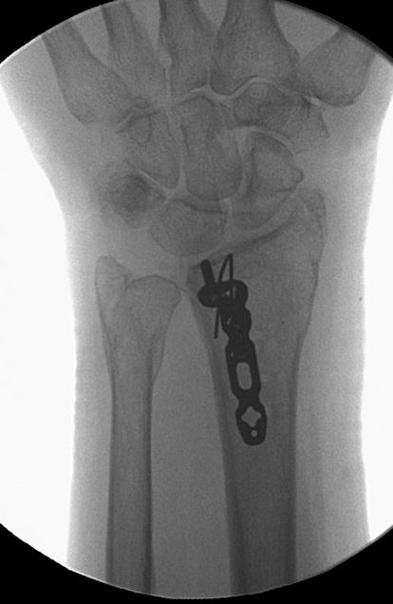
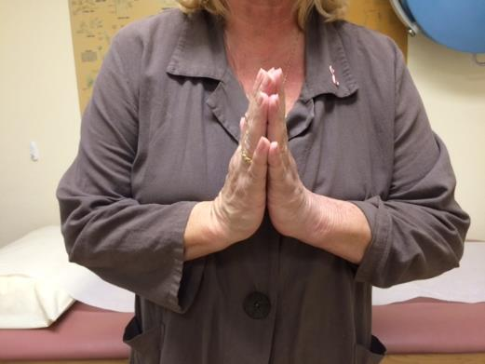
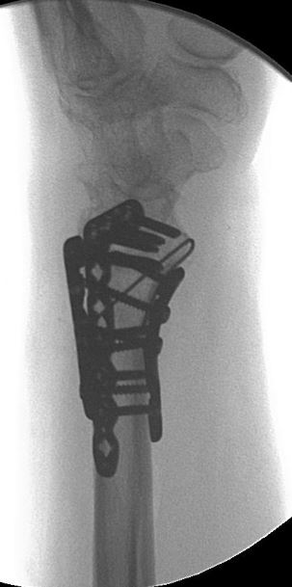
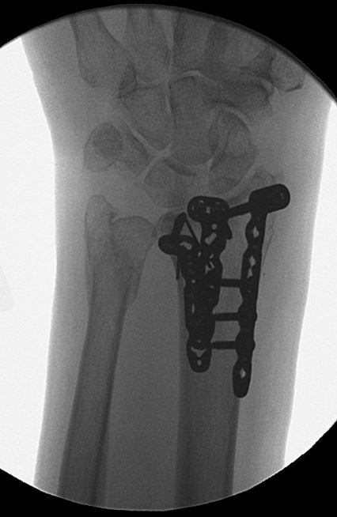

Slide 19
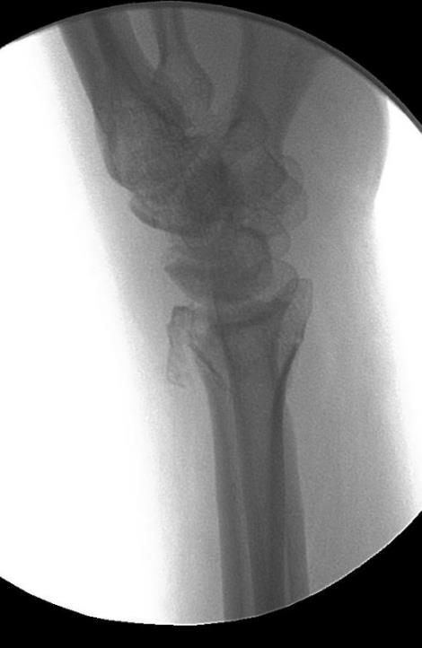
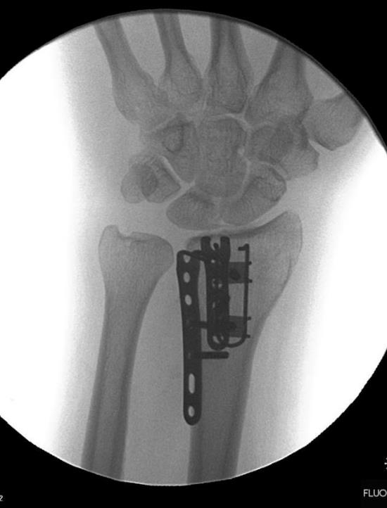
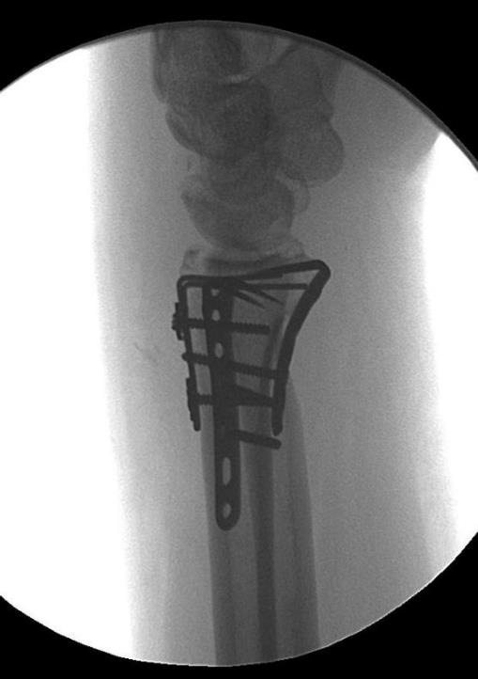

Slide 20
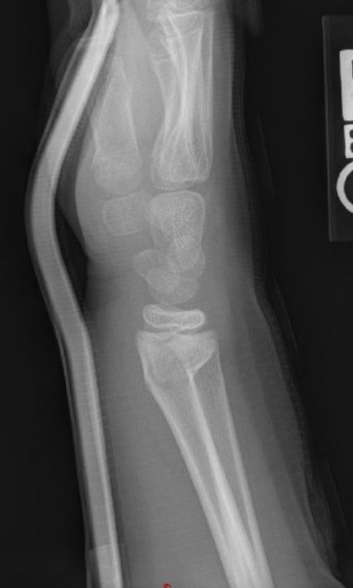
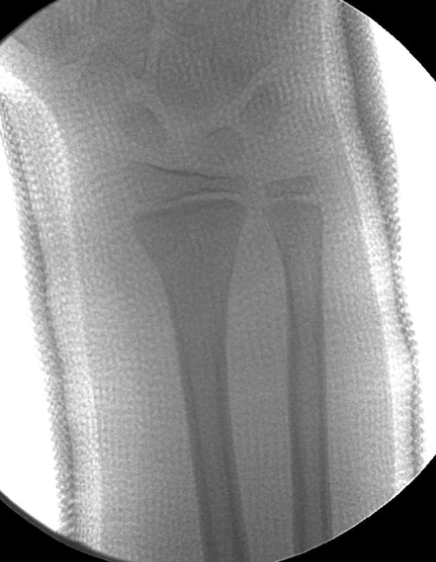
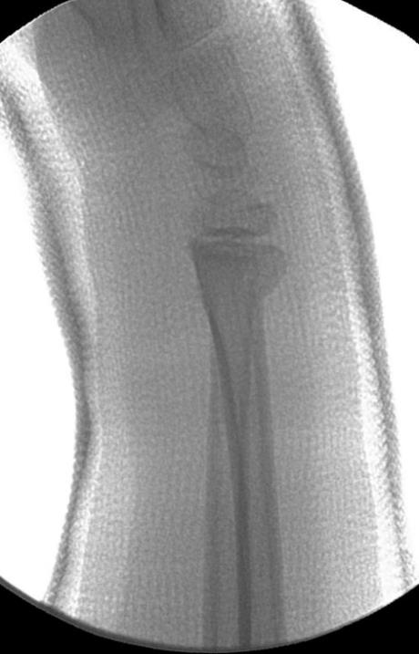
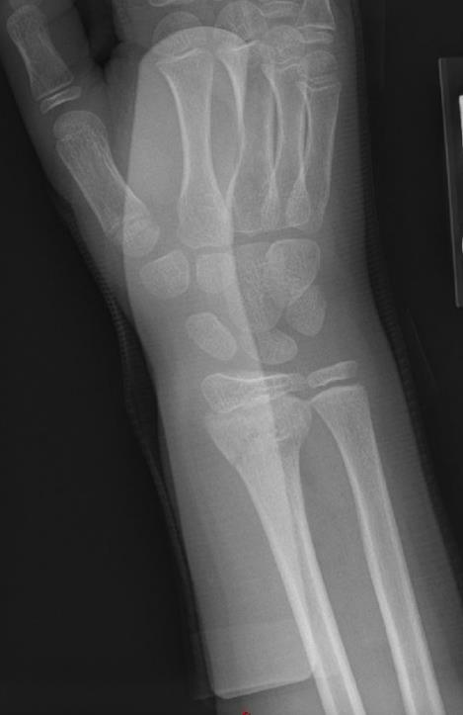
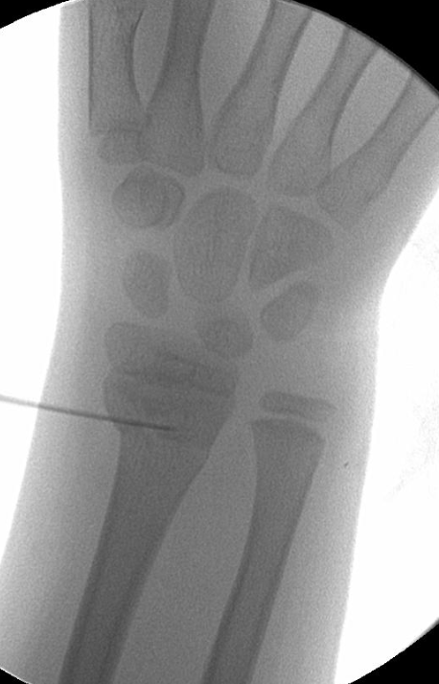

Slide 21
Forearm Fractures…
Most common fractures
Monkey bars
Trampolines
Skateboard/Scooters
Bikes
Rarely operative when growth plates are open
Often benefit from closed reduction
Buckle Fractures
Current trend favors no-splinting (stable fractures)

Slide 22
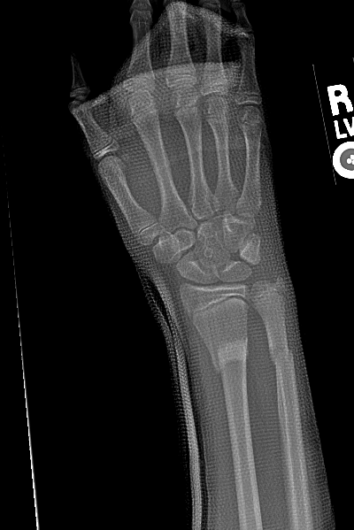
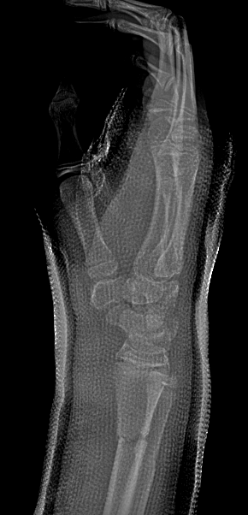
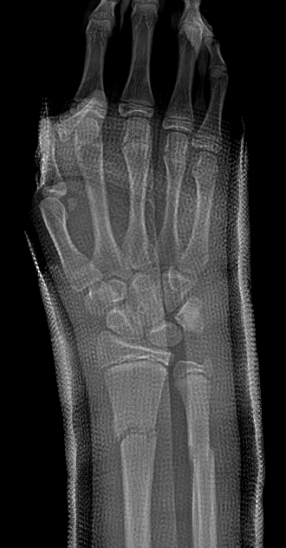
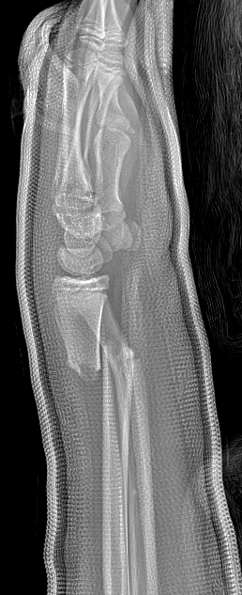
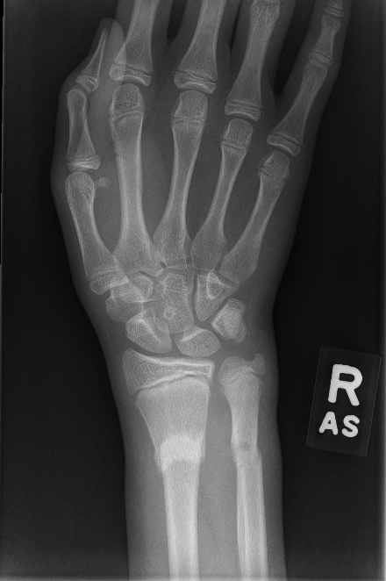

Slide 23
Scaphoid Fractures
Historically missed, but now higher awareness
High-energy FOOSH: skateboards, bicycles, skiing
Snuffbox tenderness
If confirmed fracture ➔ Cast x 8 weeks
If suspected fracture ➔ Cast with repeat imaging/exam in 1 week
If low suspicion ➔ Splint and re-exam in 1 week
If uncertain ➔ MRI or CT scan appropriate
MRI lower radiation risk for kids, but higher cost

Slide 26
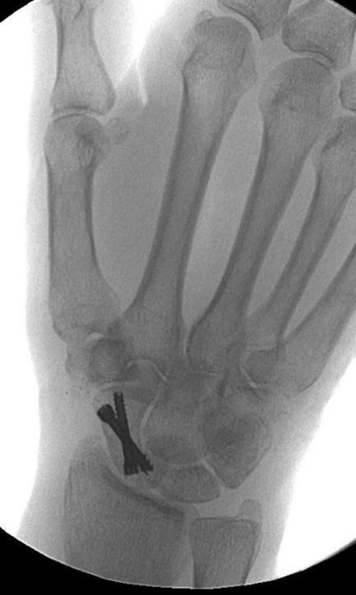
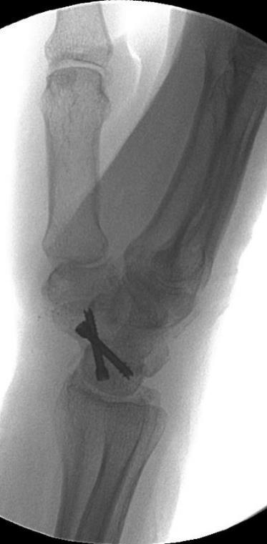

Slide 27
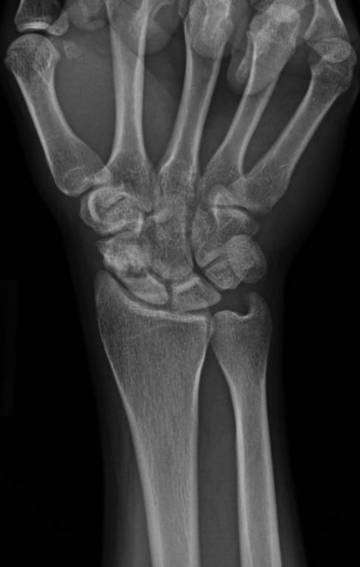
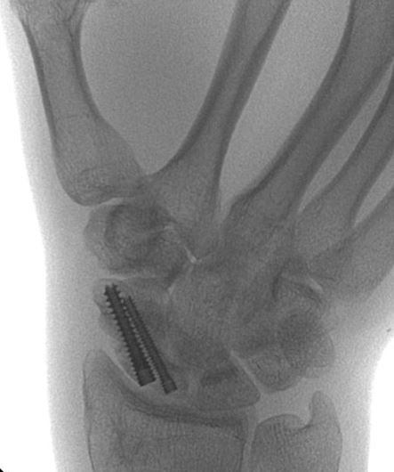

Slide 28
Finger Injuries
Seymour fractures (distal phalanx growth plate)
Nail bed injuries
Dislocations

Slide 29
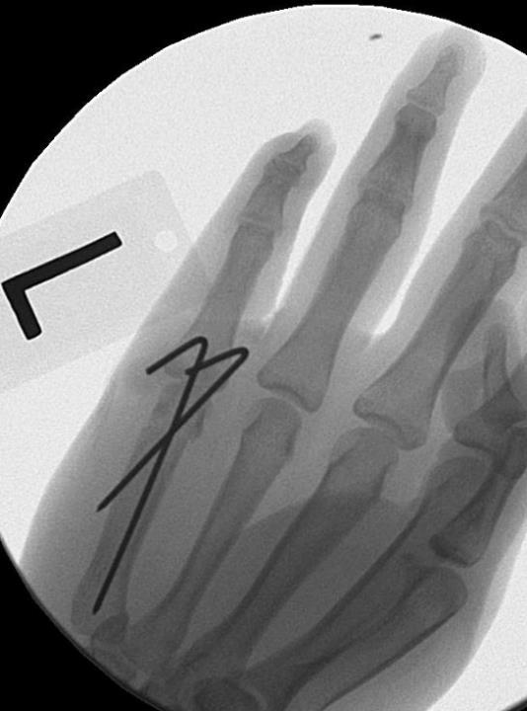
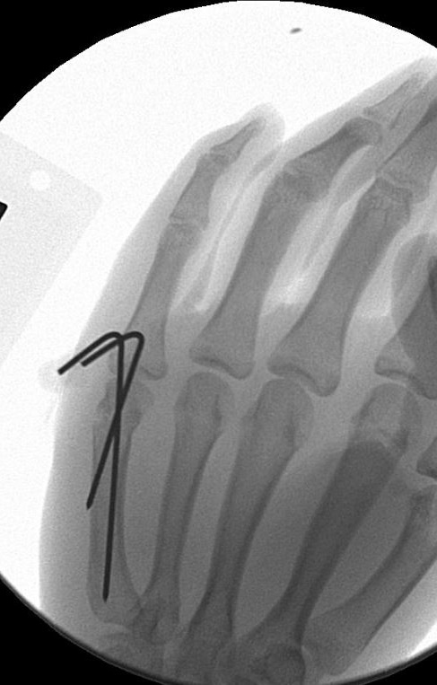

Slide 30
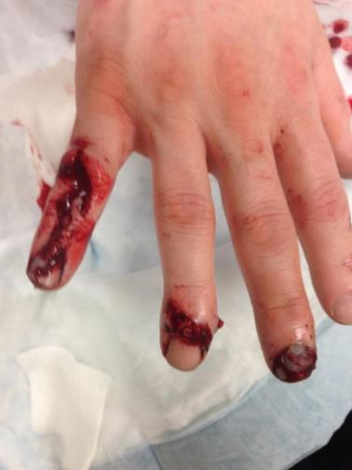
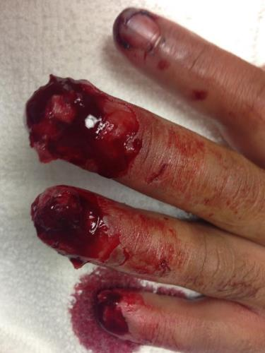
Fingertip Injuries

Slide 31
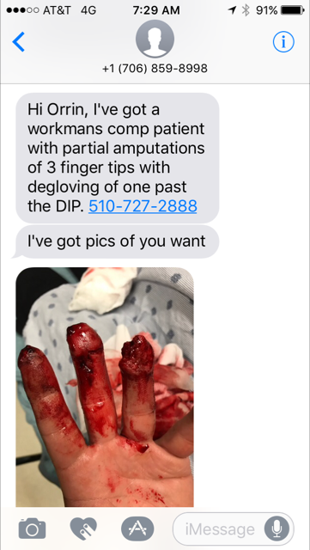

Slide 32
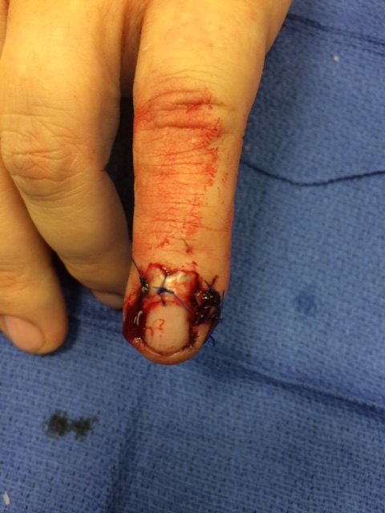

Slide 33
Nail Bed Laceration
Obtain Xray - foreign body and fracture
Antibiotics if fracture (open)
Replace nail below eponychial fold
Use 5-0 Chromic suture for everything

Slide 36
Atasoy 1970 (Tranquilli-Leali in 1935)
V apex just distal to DIP crease
Full thickness flap to NVB
Fibrous septae released
Advance flap
Repair apex or allow to granulate
Risk of nail plate deformity

Slide 38
*Highest online reviews (Yelp, HealthGrades, Vitals)
*Cash prices listed online
*Patient outcomes collected and posted online
Innovative, modern, efficient hand practice
20 minutes from Milvia St.
Same-day appointments for emergencies
In-office procedure room
In-building surgery center
X-ray, casting, therapy all in one location
www.EBHMC.com

Slide 39
How to get ahold of me?
Cell: 858-337-7149
Referral form: www.ebhmc.com/referral
Google me.
*Download: www.ebhmc.com/vcf

Slide 40
Thank you!

