Slide 1
Hand “Tricks” and Finger “Tips” for Emergency Providers
Orrin Franko
Orthopedic & Hand Specialist

Slide 2
Disclosures
Owner/Founder: www.TopOrthoApps.com
Owner/Founder: www.SurgiSurvey.com
No relevant financial disclosures related to the topic of this presentation.

Slide 3
Orrin I. Franko, MD
Childhood: Palos Verdes, CA
Undergraduate: UC San Diego (2005)
Medical: Harvard (2009)
Orthopedic Residency: UC San Diego
Hand Fellowship: Cincinnati, OH
Wife (Katie), 2 boys: Ari (2 yrs) & Asher (1 yr)
Hobbies: “Tech” and “mobile apps” in medicine
www.TopOrthoApps.com
Automated Surgical Outcomes
Online Physician Rating & Reputation Management

Slide 4
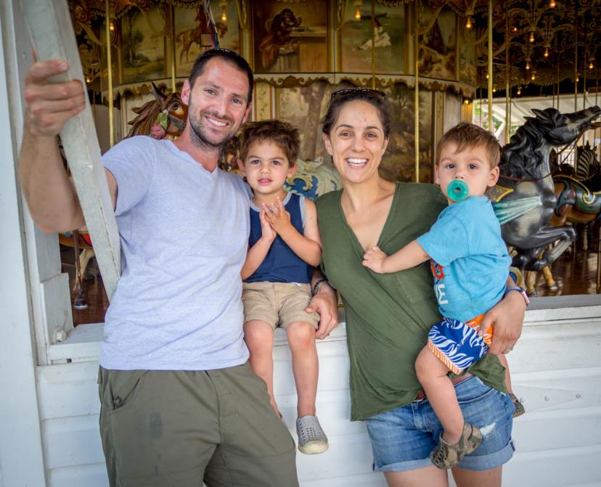
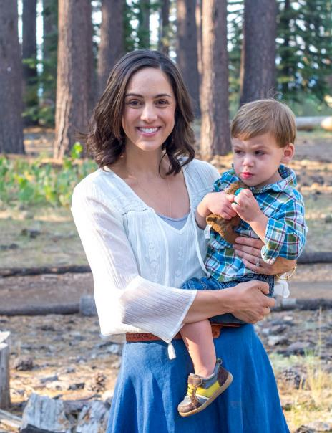
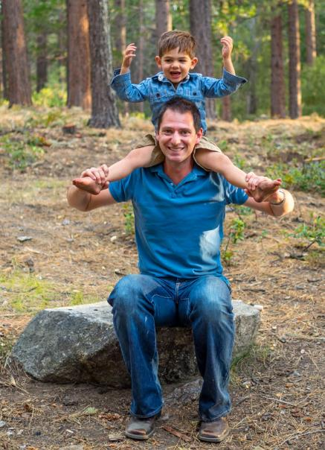

Slide 5
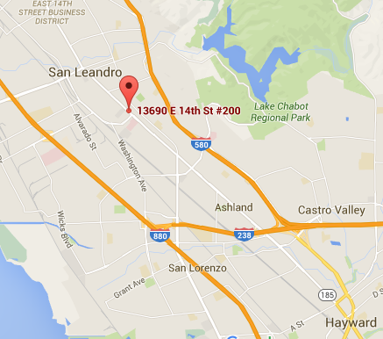
www.EBHMC.com

Slide 6
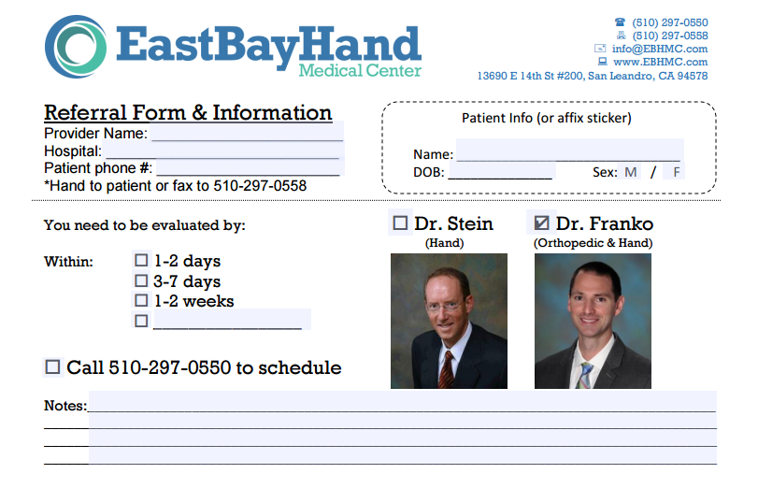
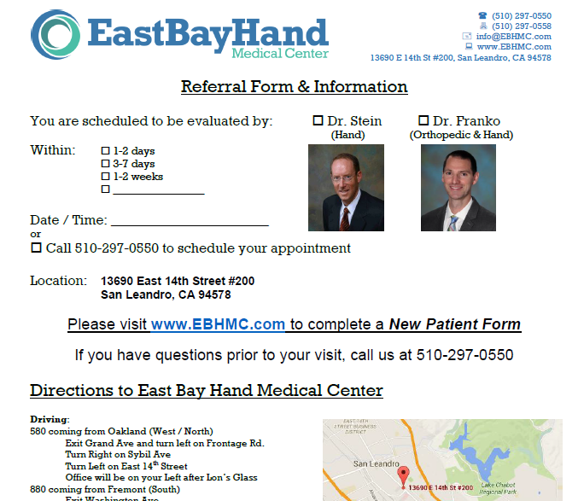
Cell: 858-337-7149 www.ebhmc.com/referral

Slide 7
The Hand
Hand Exam
Nerves, Tendons, Bones
Distal radius fractures
Metacarpal fractures
Finger fractures and dislocations
Fingertip/nail bed injuries
Infections
Replants

Slide 8
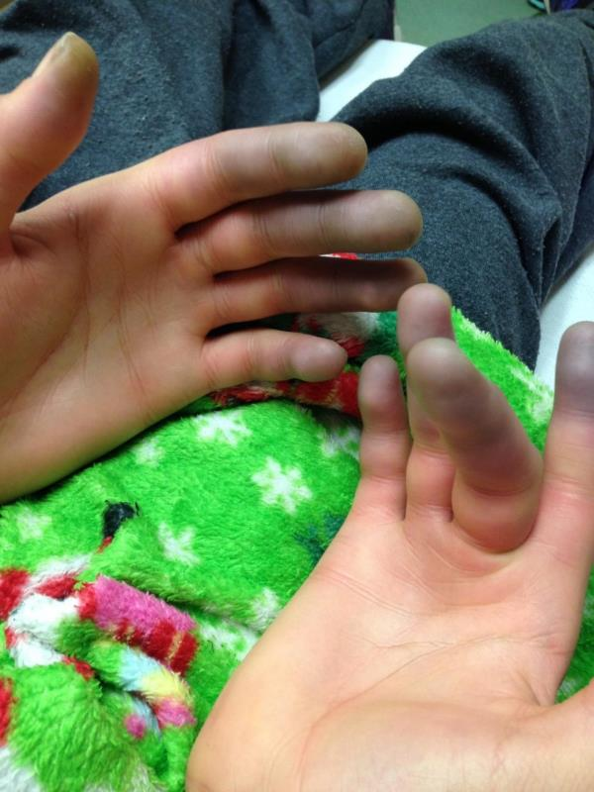
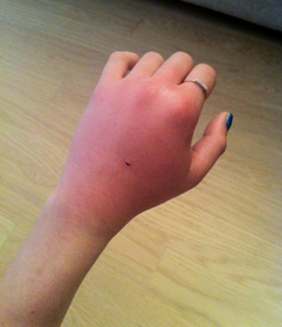
Hand Exam
Skin:
Discoloration: erythema, ischemia
Scars/wounds
Take rings off!

Slide 9
4 weeks post Distal Radius Fracture!

Slide 10
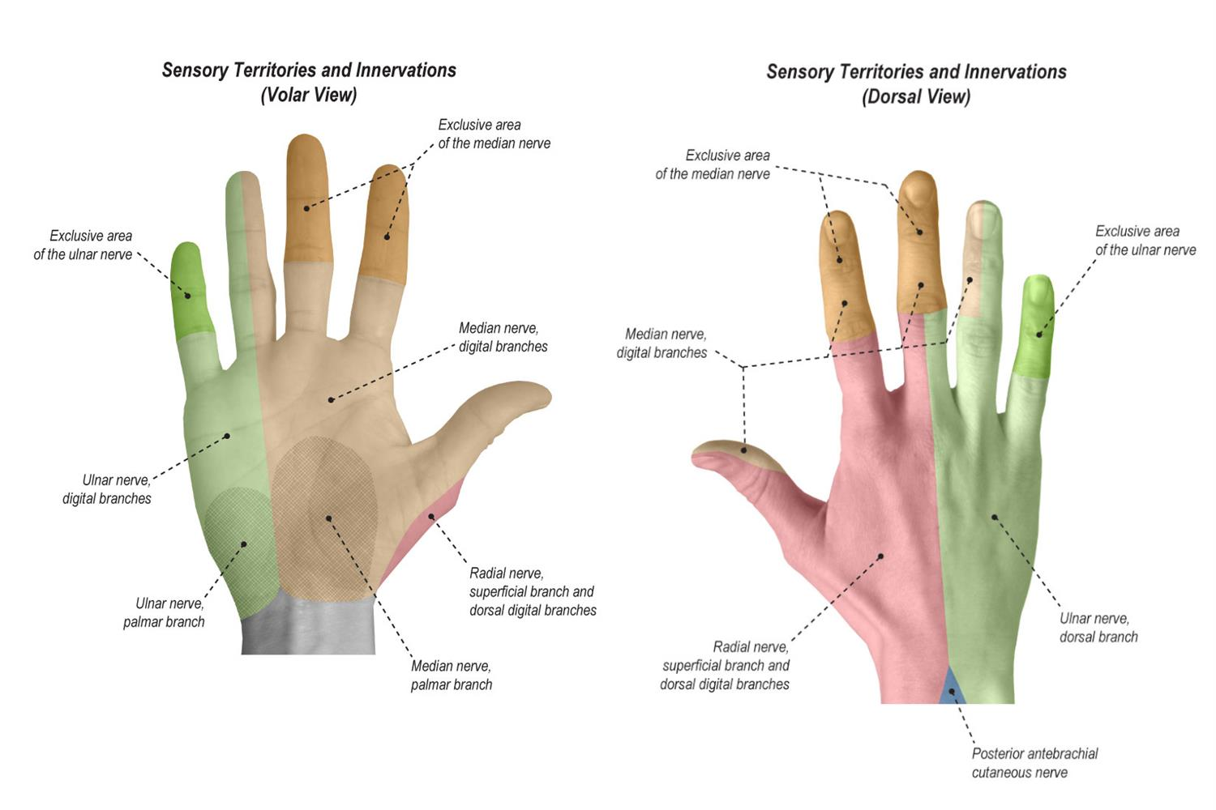
Hand Exam: Sensation

Slide 11
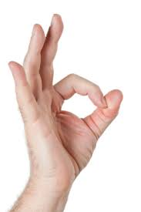
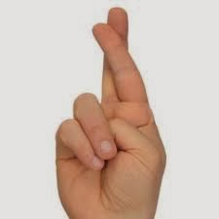
Hand Exam: Motor
Radial nerve: thumb IP joint extension (EPL)
Median nerve/AIN: thumb IP joint flexion (FPL), index DIP flexion (FDP)
Ulnar nerve: cross fingers or abduct against resistance (interossei)

Slide 12
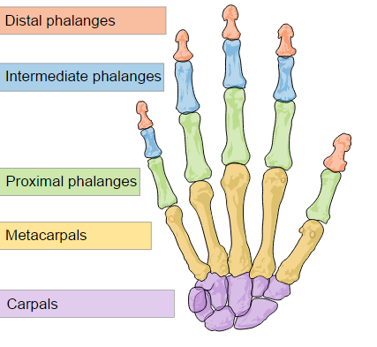
Hand Exam: Bones
Middle

Slide 13
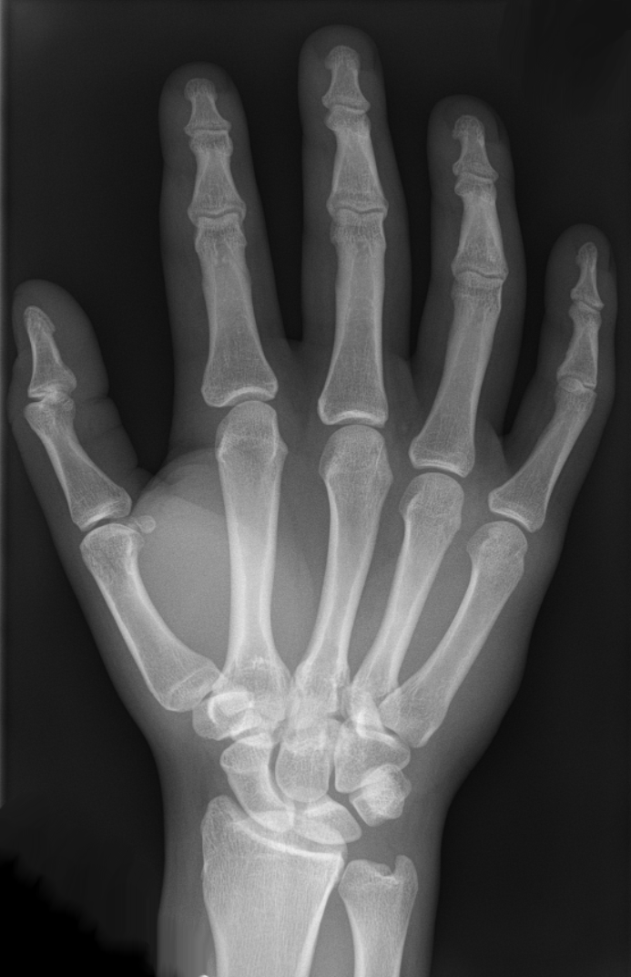

Slide 14
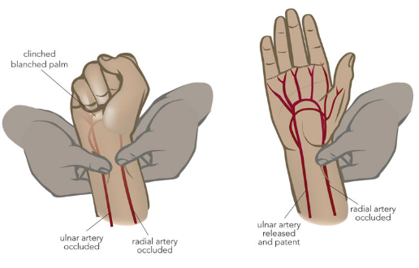
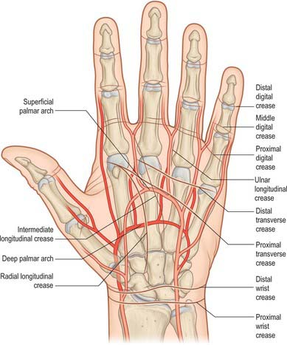
Hand Exam: Vascular
Radial pulse
Ulnar pulse
Capillary refill

Slide 15
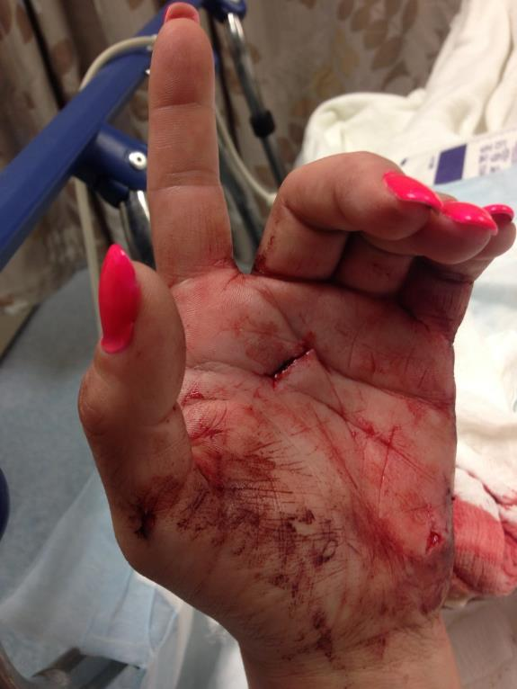
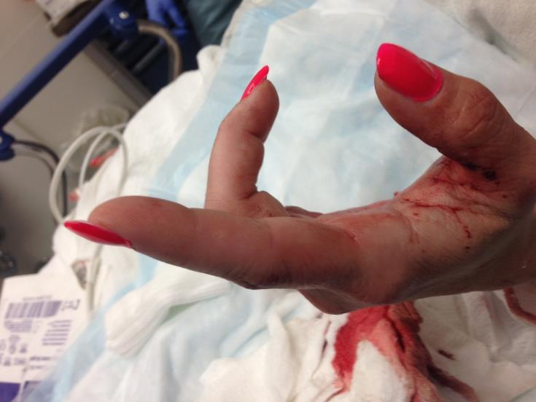
Flexor Tendon Laceration
Notes:
Observe resting posture of the hand

Slide 16
Flexor Tendon Anatomy

Slide 17
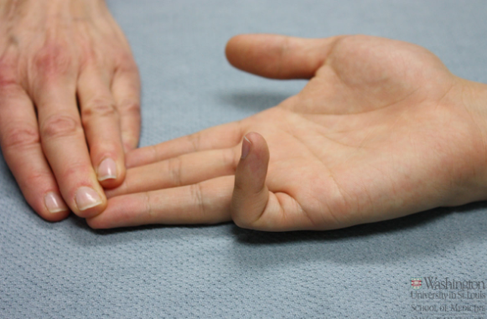
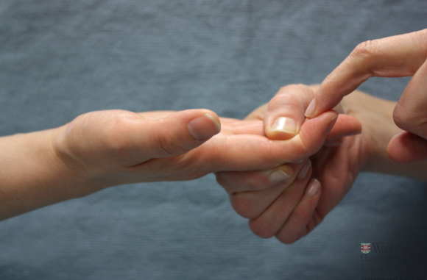
Flexor Tendon Injuries
Careful NV exam
1) Observe cascade, test FDS and FDP
FDP – test DIP
FDS – hold all but 1 finger down
Partial lacerations (<50%) treated non-op, early motion
Repair lacerations >50%, technique depends on tendon and zone of injury

Slide 18
Extensor Tendon Injuries

Slide 19
Extensor Tendon Anatomy

Slide 20
Extensor Tendon Injuries
Zone 1: Mallet Finger
Zone 3: Boutonniere deformity
Zone 5: “fight bite”
Early protected motion if <50% lac and can extend against resistance
Repair if >50% lac

Slide 21
Tips for Dorsal Lacerations:
1) Lidocaine, irrigate, explore
2) If tendon is SEEN, it’s typically NOT completely lacerated
(cut tendons retract)
Try to evaluate degree of laceration (<50% or >50%)
Ask patient to move while watching tendon
+/- Repair with 1-2 nylon sutures
Splint in position of “relaxation” for the tendon (extension for dorsal)

Slide 22
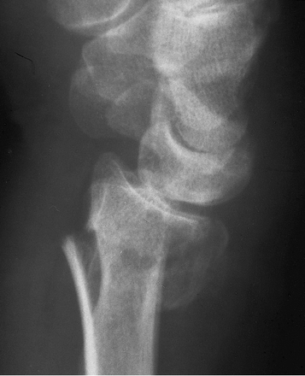
Distal Radius Fractures
Bimodal age distribution
Young patients: higher energy
Old patients: low energy/falls
Injury patterns
Dorsally displaced (Colles’ fracture)
Volarly displaced (Smith’s fracture
Radial styloid / intra-articular

Slide 23
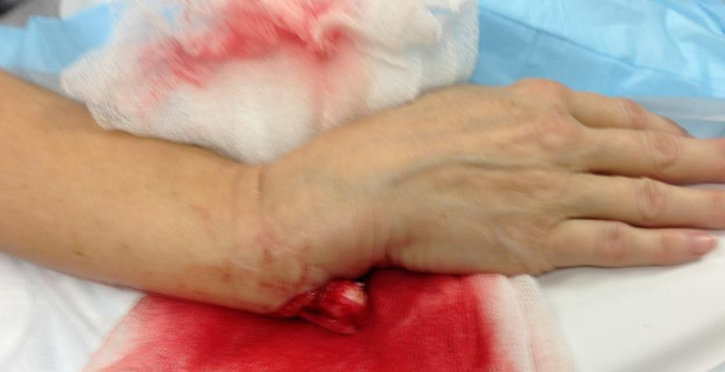
Evaluation
Exam
Skin, Deformity
Motor/sensory
Acute carpal tunnel syndrome

Slide 24
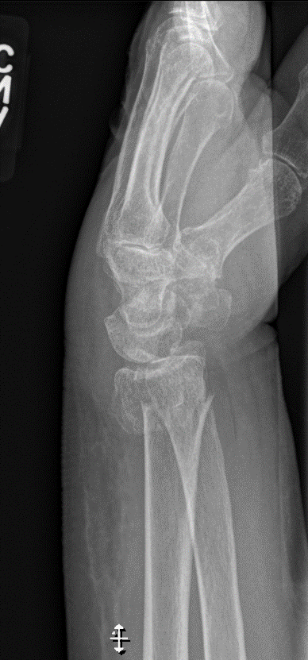
86yoF s/p fall in nursing home

Slide 25
Distal Radius Fractures
23° 11mm 11°
(change <5°) (5mm) (dorsal angulation <5°)
Notes:
23 degrees radial inclination (change <5)
13mm radial height (loss of 5mm)
Volar tilt 11 degrees (dorsal angulation <5 acceptable)

Slide 26
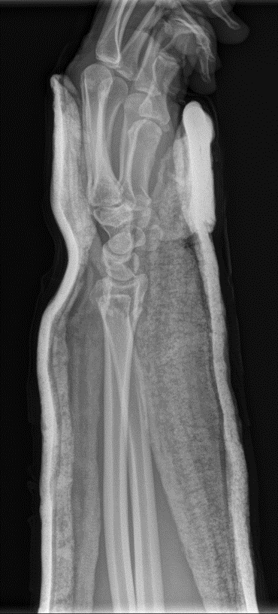
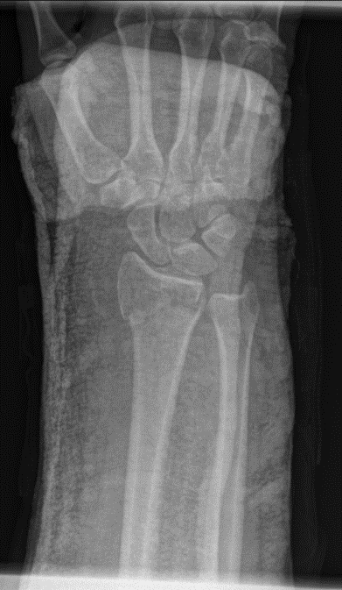
Distal Radius: Reduction
Goal: restore alignment
Height
Volar tilt
Exception:
Significant comminution (reduction won’t hold)
No displacement (reduction not needed)
Absolutely requires surgery (reduction not necessary)
*Assuming no carpal tunnel symptoms
Notes:
Might save them a surgery

Slide 27
DRFx: To Reduce or Not?
ALWAYS reduce:
- Carpal tunnel symptoms (bone pushing median nerve)
- Open fractures (irrigate first)
- Skin tenting (risk of open fracture)
- Carpal dislocation / translation
LIKELY reduce:
- Extra-articular / severe angulation (avoid surgery)
- Elderly (avoid surgery)
CONSIDER not reducing:
- Significant comminution
- Intra-articular with shortening
- Anatomic alignment

Slide 28
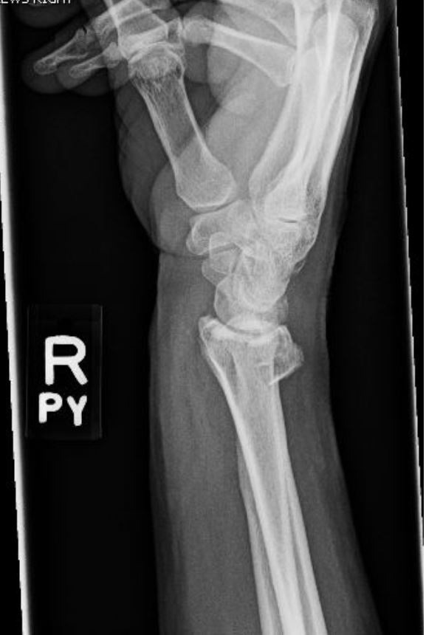

Slide 29
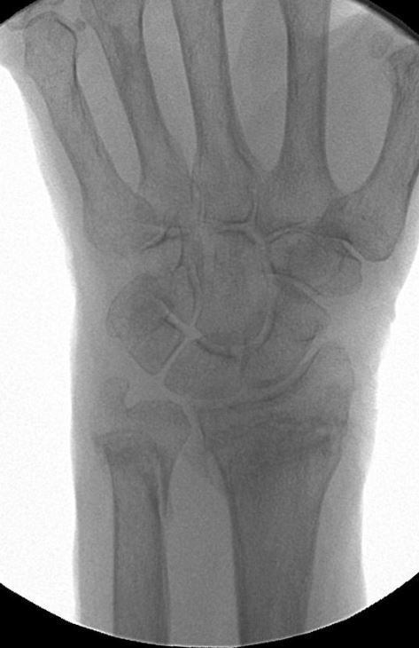
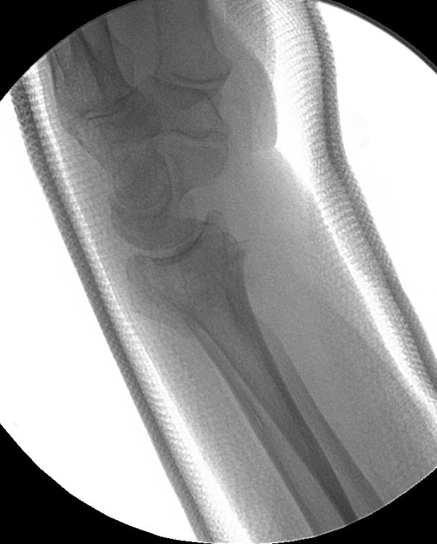
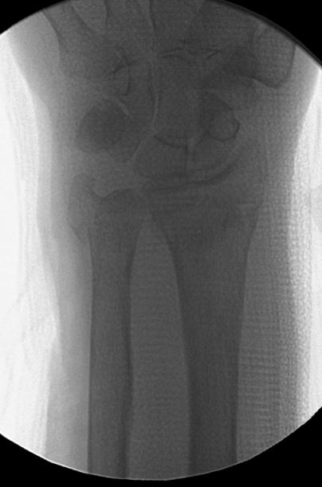

Slide 30
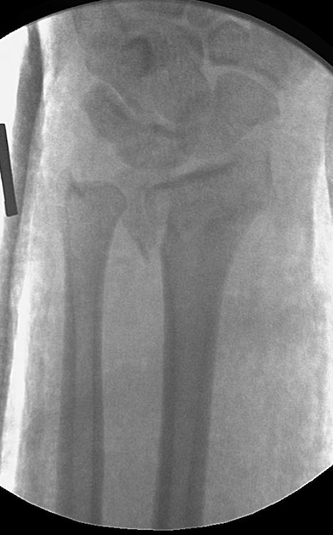
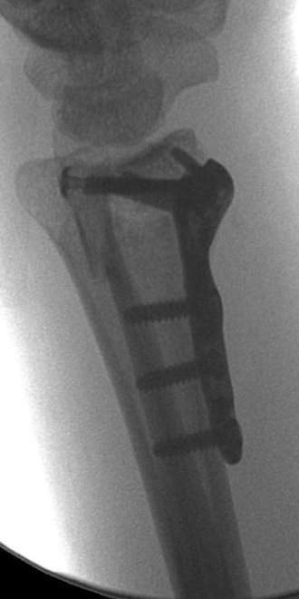

Slide 31
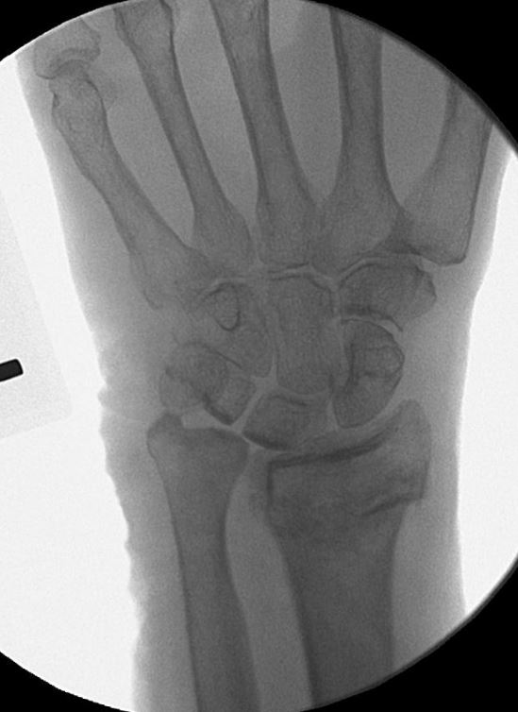
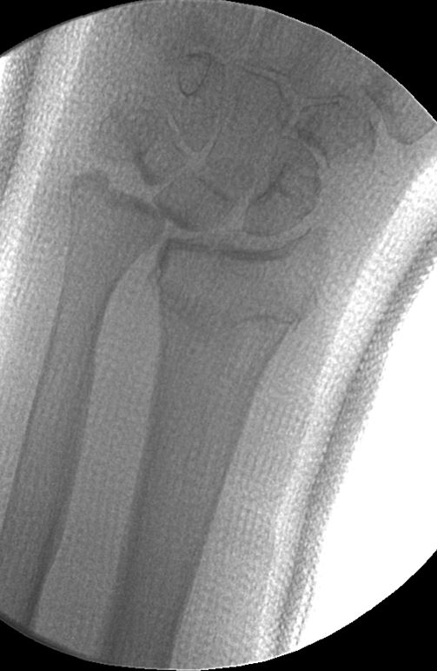
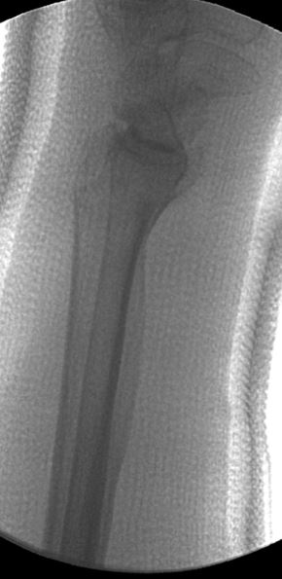

Slide 32
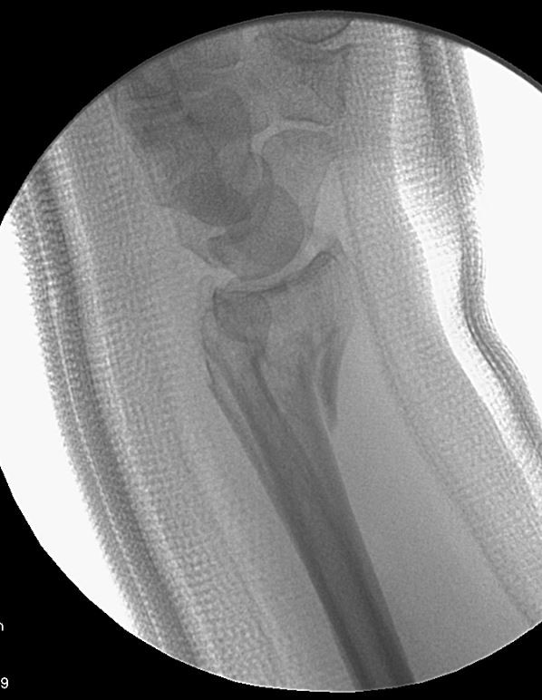
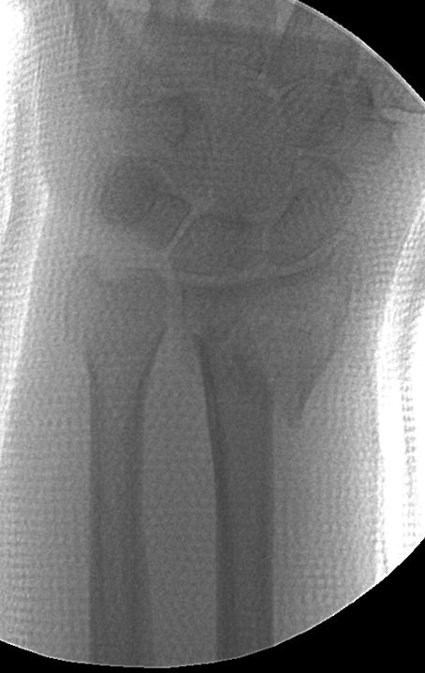
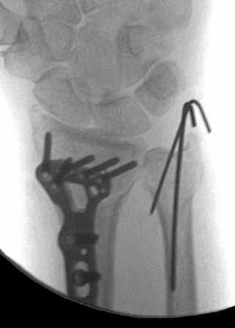

Slide 33
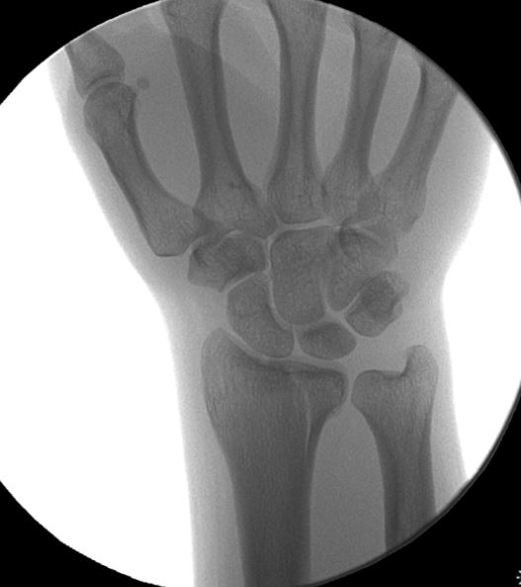

Slide 34
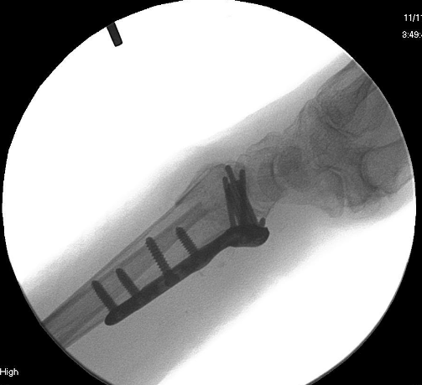
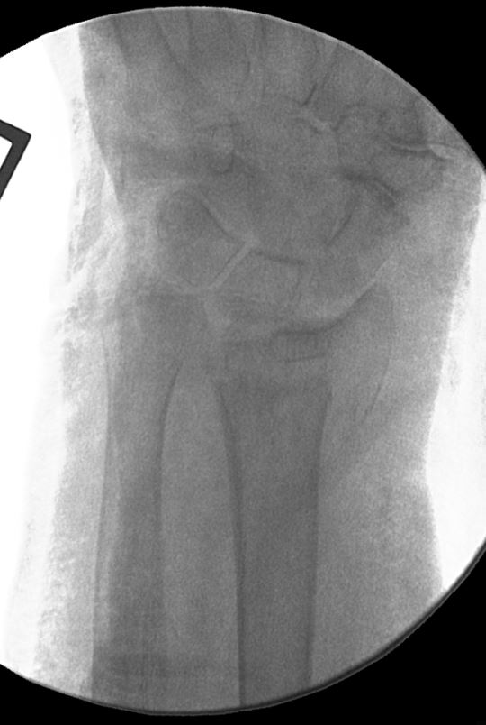
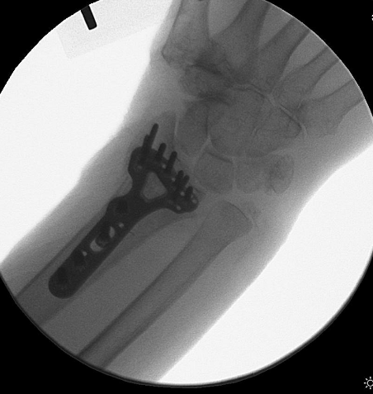

Slide 35
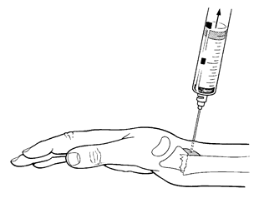
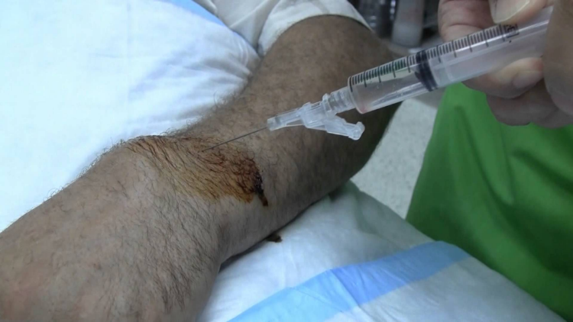
Reduction Techniques
Sedation
Hematoma block
10cc of 1% lidocaine
Inject at fracture site, will see flash of blood

Slide 36
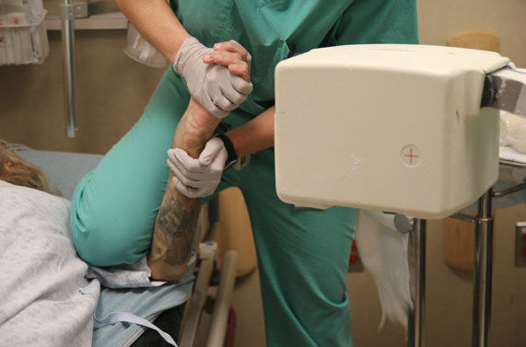
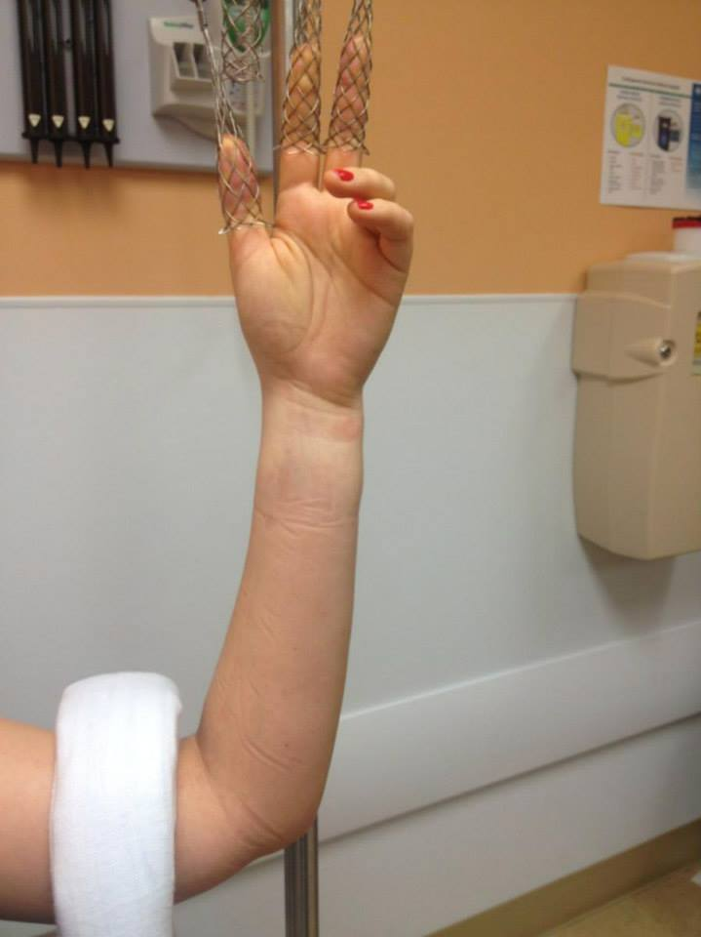
Reduction Techniques
You will need:
IV pole, finger traps
Weights
Splint materials
Mini C-arm

Slide 37
My preferred position: (sit on the patient’s arm)
*Tip: Instructions on my website at www.ebhmc.com/tips

Slide 38
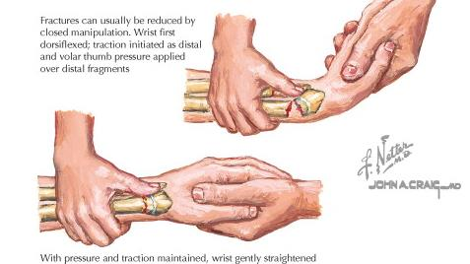
Reduction Techniques
To reduce:
Traction
Re-create deformity
Push fragment
Mold your splint

Slide 39
41yoF s/p MVC

Slide 40
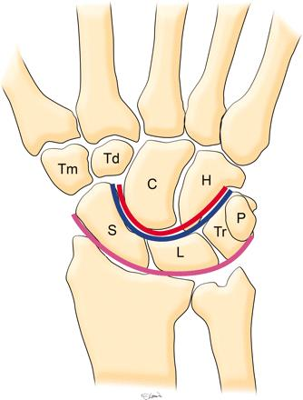
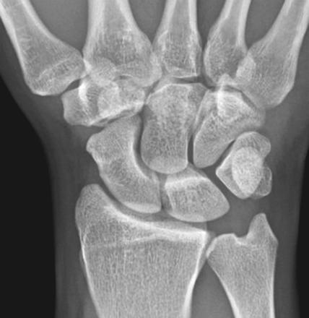
Perilunate Dislocations
High energy injuries
Commonly missed

Slide 43
Scaphoid Fractures
Mechanism: fall on outstretched arm
Not always seen on initial XR
Thumb spica splint if low suspicion and follow-up with hand

Slide 44
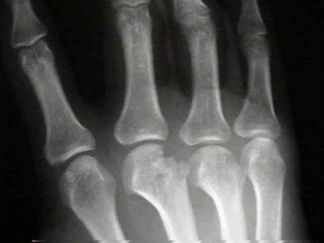
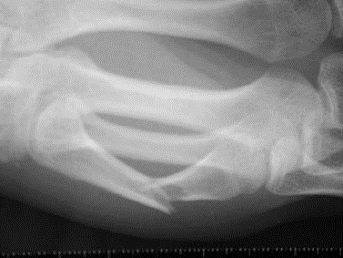
Metacarpal Fractures
Common in men age 10-29
Fracture patterns:
Head
Neck
Shaft
Acceptable deformity
* Check for ROTATION

Slide 45
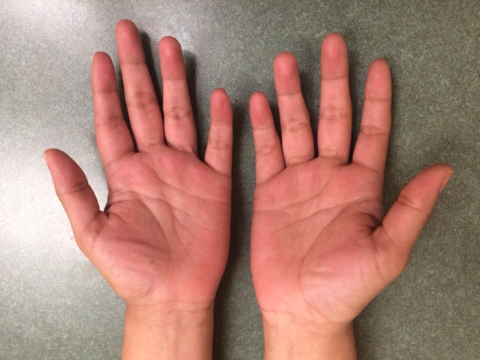

Slide 47
Boxer’s fracture
5th metacarpal neck fracture
Usually from punching something/someone
Look for “Fight bite”
Eikinella corrodens

Slide 48
Reduction Techniques
Jahss technique: 90° MCP flexion, dorsal pressure through proximal phalanx while stabilizing metacarpal

Slide 51
PIP Joint Dislocations
Dorsal more common
Simple dorsal dislocation: reduce, buddy tape
Fracture-dislocation
Splint in stable position
Volar dislocation:
Open reduction required in most cases

Slide 52
Reduction Techniques
Digital block:
5cc 1% lidocaine
Volar at the digital crease – right in the middle
One shot – works every time.

Slide 53
Reduction Techniques
Re-create deformity, traction

Slide 54
Fingertip Injuries

Slide 57
Subungual Hematoma
If <50% surface, incise and drain with cautery or 18G
If >50%, remove nail plate and repair nail bed

Slide 58
Nail Bed Laceration
Obtain Xray - foreign body and fracture
Antibiotics if fracture (open)

Slide 60
ANATOMY OF THE FINGERTIP
Peronychium
Eponychium
Hyponychium
The nail complex (perionychium) includes the nail plate, the nail bed, and the surrounding skin on the dorsum of the fingertip (paronychium)
The distal margin of the nail wall, which adheres to the nail plate, is called the eponychium

Slide 61
ANATOMY OF THE FINGERTIP
Sterile Matrix
Germinal Matrix
Nail bed
The nail bed is adherent to the very thin periosteum over the distal two thirds of the distal phalanx and consists of the sterile and germinal matrices
The germinal matrix is located proximally and forms the ventral floor of the nail fold – this is responsible for nail growth
The lunula is the distal margin of the germinal matrix
The sterile matrix is the portion of the nail bed distal to the lunula and is adherent to the nail plate

Slide 62
EVALUATION
History and mechanism of the injury
Patient factors: age, gender, handedness, occupation, and history of previous hand injuries
Function of flexor and extensor tendons
Radiographs
IV antibiotics and tetanus prophylaxis

Slide 63
EVALUATION
Anesthesia is best obtained via a digital nerve block
A bloodless field is essential:
Penrose drain tourniquet
Tournicot (NEVER remove tag)
Lidocaine with Epinephrine (SIMPLE)
1% lido + 1:100,000 Epi
2mL sufficient
It is important to know whether there is loss of skin pulp tissue and the amount of loss, is there bone exposed, and is there an injury to the nail bed
Treatment is dependant on the above information

Slide 65
EVALUATION
It is also important to determine the angle of amputation:
A,B : Volar oblique
C : Transverse
D : Dorsal oblique

Slide 66
SOFT-TISSUE LOSS WITHOUT EXPOSED BONE
There are two treatment options for this injury:
Skin graft
Healing by secondary intention
Smaller wounds (<1 cm²) should be treated nonoperatively

Slide 67
SOFT-TISSUE LOSS WITHOUT EXPOSED BONE
Treatment via open technique
Complete healing takes 3 - 5 weeks and occurs by wound contraction and epithelialization
Xeroform/adaptec
Dressing changes starting on day 2
Begin soaking the finger in a warm solution once a day and to apply a light bandage
Referral to hand therapy for a fingertip protector
Follow-up Hand Clinic 5-8 days

Slide 68
SOFT-TISSUE LOSS WITH EXPOSED BONE
When bone is exposed, satisfactory soft-tissue coverage must be obtained.
Treatments
revision amputation
local flaps
regional flaps

Slide 69
SOFT-TISSUE LOSS WITH EXPOSED BONE REVISION AMPUTATION
Shortening and primary closure of fingertip amputations is indicated in adults of any age when not enough sterile matrix (<5mm) remains to produce an adherent, stable nail
The remaining nail matrix must be ablated, and this can be accessed by reflecting the nail wall proximally
If the flexor and extensor tendons cannot be preserved, the DIP should be disarticulated, traction applied to the tendons, then transected

Slide 70
SOFT-TISSUE LOSS WITH EXPOSED BONE LOCAL FLAPS
Defined as a flap in which the transferred tissue is confined to the injured digit, with at least one side of the flap adjacent to the defect
Advantages : can be used in patients of any age, they preserve length, the donor defect does not require a skin graft, and the transposed tissue is similar in quality, texture, and color to that of the recipient site
Types : V-Y flap (Kleinert) and Kutler flap

Slide 71
SOFT-TISSUE LOSS WITH EXPOSED BONE LOCAL FLAPS : V-Y FLAP
This flap is ideal for transverse or dorsal oblique amputations
The critical value is whether enough palmer tissue is available for distal advancement (~7-10mm)
Patients usually have near normal sensation and good restoration of contour and padding

Slide 72
Atasoy 1970 (Tranquilli-Leali in 1935)
V apex just distal to DIP crease
Full thickness flap to NVB
Fibrous septae released
Advance flap
Repair apex or allow to granulate
Risk of nail plate deformity

Slide 73
SOFT-TISSUE LOSS WITH EXPOSED BONE LOCAL FLAPS : V-Y FLAP
This flap is most appropriate for distal transverse amputations
The disadvantage of this technique is that the flaps are small and may be difficult to advance

Slide 74
Kutler 1947
Radial or Ulnarly (or both) based flap
Similar elevation and advancement
May have scar sensitivity

Slide 75
Moberg Advancement
Thumb amputations distal to IP joint
Success because of dorsal arterial supply
Raise from distal → proximal
Continue to digital flexion crease (MP)
Incorporate both NVBs
Risk: IP flexion contracture
Consider transverse cut at base of flap

Slide 76
SOFT-TISSUE LOSS WITH EXPOSED BONE REGIONAL FLAPS
The two most commonly used regional flaps are cross-finger flap and the thenar flap
Used for amputations that are volar oblique or too proximal to allow a local flap
The main disadvantage is it involves a two stage procedure
Contraindicated in patients with osteophytes or arthritis of the involved digits and in patients with systemic conditions such as RA, diabetes, and vasospastic disorders

Slide 77
SOFT-TISSUE LOSS WITH EXPOSED BONE REGIONAL FLAPS : CROSS-FINGER FLAP
The standard cross-finger flap is a rectangle over the middle phalanx of the donor digit, with the hinge side adjacent to the injured finger
A full-thickness skin graft from the groin or elsewhere is applied to the donor defect
Flap division is performed 12-14 days after the initial procedure

Slide 78
Thenar Flap
Used for larger volar defects
Typically index/long finger
Risk of PIP flexion contractures
Elevate proximally based flap at thumb MP crease
Risk of radial digital nerve
Flex MP/DIP to avoid PIP contractures
Divide and inset at 2-3 weeks

Slide 86
NAIL-BED INJURIES
Spectrum of injuries
Subungual hematomas
Simple and complex lacerations
Avulsions of matrix tissue
It is important that the nail bed be repaired with great attention to detail in order to restore function and prevent annoying and unsightly deformities

Slide 87
NAIL-BED INJURIES - SUBUNGUAL HEMATOMAS
Decompression of a subungual hematoma should be performed to relieve pain if it involves > 50% of the area of the nail
This can be done with a heated paper clip or 18 gauge needle
For larger subungual hematomas, the nail plate should be removed to repair the nail bed
If subungual hematoma >50% of nail plate → 60% requiring repair
If underlying fracture → 95% requiring repair

Slide 88
NAIL-BED INJURIES LACERATIONS
Lacerations are repaired after the nail plate has been removed
The nail plate is carefully separated from the nail matrix with a Freer
The wound is then irrigated and debrided, taking care that all matrix tissue is retained
Fractures of the distal phalanx can usually be stabilized by suturing the skin of the lateral nail folds and the nail bed

Slide 89
NAIL-BED INJURIES LACERATIONS
Traditionally, lacerations of the skin and lateral nail folds should be repaired with 5-0 nylon. Chromic also acceptable.
The nail bed is meticulously approximated with absorbable 5-0 or 6-0 chromic
Evidence shows dermabond can be just as effective for stellate injuries
If the laceration extends into the germinal matrix, the nail wall should be reflected proximally by making an incision on each side of it, extending from the eponychium
After repair, the nail plate should be placed back into the nail fold to prevent scar formation
If nail not available, use foil, adaptec, xeroform, plastic, etc.

Slide 90
Dermabond vs. 6-0 Chromic Suture for nail bed repair
18 pts vs. 22 pts

Slide 91
SUMMARY
For the treatment of fingertip injuries, the decision making process should proceed from the simpler techniques to the more complicated
When no bone is exposed, the open method is ideal for small or moderate sized wounds, and skin grafting should be considered for larger wounds
Distal transverse and dorsal oblique amputations with bone exposure can be treated with local advancement flaps (V-Y)

Slide 92
SUMMARY
More proximal and volar oblique amputations can be managed with a regional flap to preserve length if enough sterile matrix remains for a stable nail
Shortening and primary closure can be used for amputations not amendable to other methods of treatment

Slide 93
Take-Home Points for ED Providers
Get XR, block the finger, irrigate, and assess injury (remove nail plate)
If simple laceration and easily closed → use 6-0 chromic vs. Dermabond
Always place something under nail fold (nail, adaptec, etc)
If complex laceration and soft tissue okay → Dermabond
If bone exposed and skin closeable → 6-0 chromic
**** Call Hand surgeon if considering any of the following ****
If bone exposed but not closeable → shorten vs. V-Y flap vs. Moberg
If extensive soft tissue injury → shorten vs. regional flap

Slide 94
Call me for fingertips…
*Tip: Instructions on my website at www.ebhmc.com/tips
(copy/paste supplies into order)
Digital block: 0.25% Marcaine + Epi, 10cc syringe, 18g, 25g, alcohol swab Prep: Tournicot/Penrose per digit, 4×4 box x 2, iodine bottle, chux x 2, 2 packs sterile blue towels Irrigation: large basin, 500cc Saline, screw-on irrigation cap Laceration kit: toothed pickup, iris scissors, hemostat, needle driver (preferably from OR) For nail/tuft injuries: freer elevator, small rongeur (from OR) Closure: 5-0 chromic suture, xeroform, 4×4 gauze, 2″ kling, alumifoam splint, 2″ ACE wrap, tape

Slide 95
Hand Infections: Paronychia
Most common hand infection
Staph aureus
Proximal or lateral nail fold
I&D, warm soaks, oral antbiotics

Slide 96
Hand Infections: Felon
Abscess of the finger pulp
Staph aureus
I&D, IV antibiotics

Slide 97
Cat Bites
Higher infection rate than dog bites
Pasteurella multocida
IV abx, splint, surgical I&D if abscess/no improvement

Slide 99
Flexor Tenosynovitis
Infection of flexor tendon sheath
Penetrating trauma to tendon sheath or direct spread from felon, septic joint
Staph aureus most common

Slide 101
Flexor Tenosynovitis
Knavel’s signs
1. Flexed posturing of the involved digit
2. Tenderness to palpation over the tendon sheath
3. Marked pain with passive extension of the digit
4. Fusiform swelling of the digit

Slide 102
Tips on Infections…. Bigger is Better. Always.

Slide 104
Amputations

Slide 105
Call me first….
Indications for Amputation
Thumb amputation
Multiple digits
Through the palm
Wrist or proximal to wrist
Almost all parts in children
Revision amputations in ER (easily performed)
Accepting institutions may need to speak with evaluating surgeon

Slide 106
Amputations
Contraindications: crush or avulsion, prolonged ischemia time, segmental amputation, medically unstable patient

Slide 108
Replants
When:
Proximal to wrist:
Warm ischemia time <6h
Cold ischemia time <12h
Distal to wrist:
Warm ischemia time <12h
Cold ischemia time <24h

Slide 109
Replants
Operative sequence:
Bone
Extensor tendon
Artery repair
Venous anastomosis
Flexor tendon repair
Nerve repair
Skin +/- fasciotomy

Slide 110
High Pressure Injection Injuries
Benign entry wound
Industrial solvents and oil based paints cause tissue necrosis (more than grease, latex, water based paint)
Require urgent I&D
Delay in surgical care can lead to amputation

Slide 111
Firework Injuries
10,000 injuries/year, clustered around 4th of July
36% hands/fingers
74% male, over half <20yo

Slide 112
How to get ahold of me?
Cell: 858-337-7149
Referral form: www.ebhmc.com/referral
Google me.
*Download: www.ebhmc.com/vcf

Slide 113
Thank you!

